Slide 1
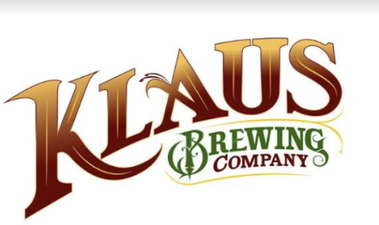

KLAUS BREWING COMPANY FINAL SOLUTION
BY:FINAL PATH CONSULTING

Slide 2
INTRODUCTION
Client: Klaus Brewing Company
Our Name: Final Path Consulting
Team members:
John Joshua Izuegbu: Project Manager
Faryal Khan: Coordinator/Designer
Chantera Lazard : Systems analyst/Coordinator/Designer
Pratik Asarpota : Designer
Sean Tran : Systems Analyst/Designer
Adekunle Kukoyi: Designer

Slide 3
OUR APPROACH
Our group has decided to take the SDLC approach towards this project by analyzing and designing with a phased approach
By using this approach, we will provide client with best deliverable solution possible and meet all their objectives as well.

Slide 4
PHASE 1
Notes:
Chantera
We will give a brief summary of our Phase I results including an introduction of our client.

Slide 5
OUR CLIENT-KLAUS BREWING COMPANY

Slide 6
PROJECT SELECTION ANALYSIS
We all had separate strategies on how we searched for clients.
Our first potential client was a salon named MC hair salon discovered by Faryal. The owner stated she was uninterested because she was not able to commit since she was too busy.
Our second potential client was a manufacturing company named Umbilicals International discovered by Chantera. The reason we decided not to go with this client is Umbilicals international recently switch CEOs and they were unsure if the new CEO would give them clearance to share information with our Consulting Firm.
Our last potential client was a brewery named Klaus Brewing Company discovered by Sean. Sean was able to secure the brewery as our client.
Notes:
Chantera
We had three prospective clients. The first client was a hair salon found by Faryal but the owner became uninterested and too busy to continue working with us.
-2nd client was a manufacturing company found by Chantera that was in the middle of switching CEO’s. It became unclear if the new CEO would allow us to continue working with the company and access their data.
-3rd client was a Brewing Company founded by Sean. Client was happy and willing to work with us and another benefit was that Sean point of contact is his family.
Moving to the next slide that covers our client’s background.

Slide 7
BACKGROUND
Klaus Brewing Company was founded by a local group of family and friends led by passionate brewer Thomas Lemke.
Focused on bringing the under-served German-style beers to a wide range of consumers, from beer aficionados to new converts alike. They chose the name Klaus because they wanted a strong traditional German name. The name's meaning is "The People’s Victory".
Recently, during the first quarter of 2020, a global pandemic took place due to which countries, cities, states nation-wide were all on a lockdown. This event had negatively affected a lot of people’s jobs and livelihoods. Some were fortunate, others not so much. Unfortunately, Klaus Brewing Company was negatively affected by this disaster and was forced to fire the entire lower level employees – Biertenders, Brewers, and the Sales Rep. They were only able to keep the managers employed.

Slide 8
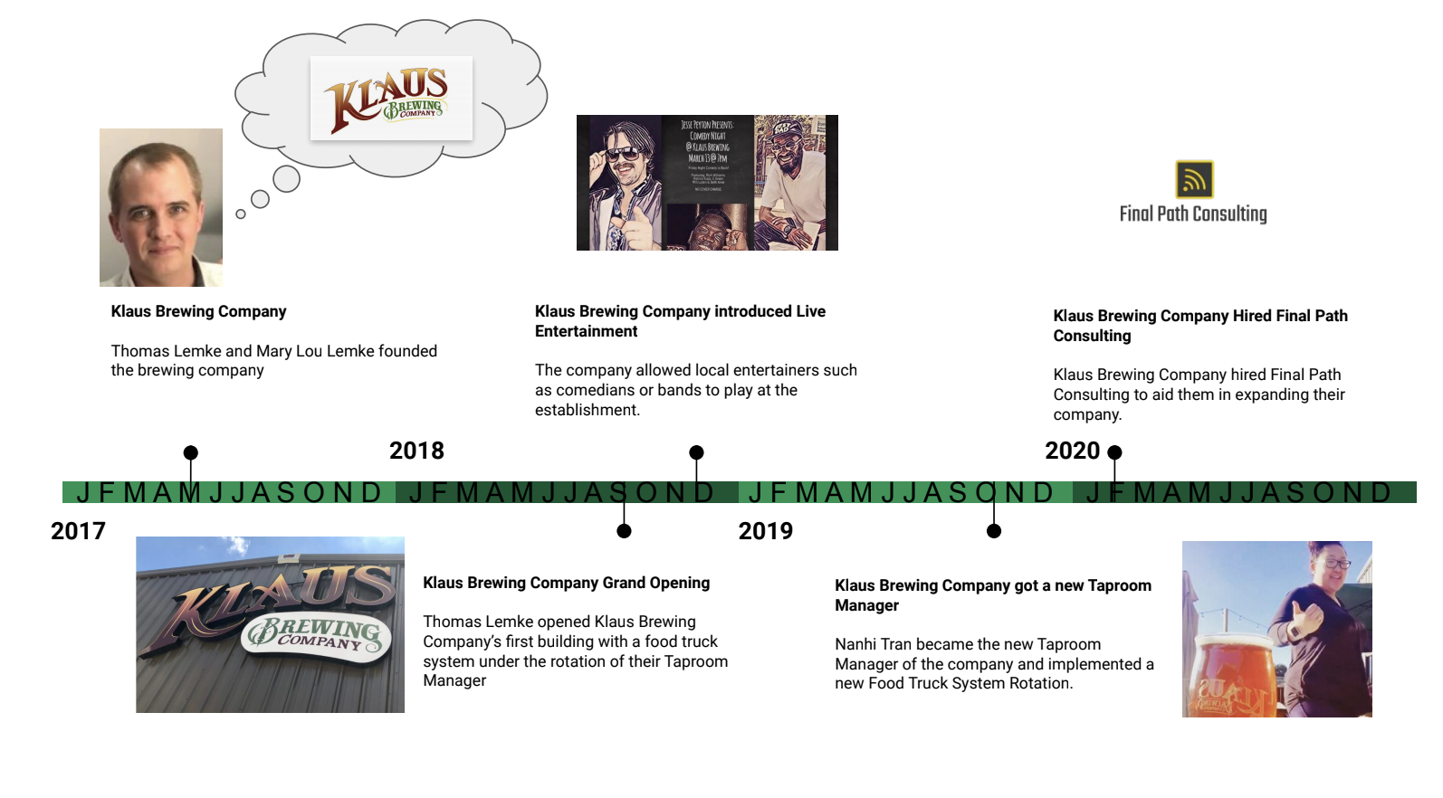
CLIENT ORGANIZATION TIMELINE

Slide 9
OUR ANALYSIS

Slide 10
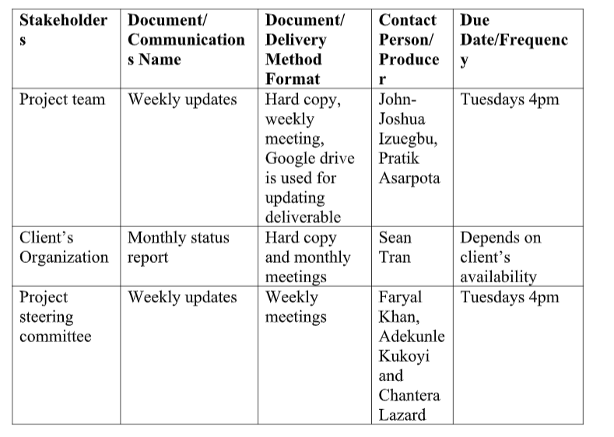
COMMUNICATION PLAN
Since communication is an extremely important key when it comes to succeeding in a project, our team is making sure that we communicate accordingly and are constantly keeping in check what updates or issues we need to work on as a team and as individuals.
Using google drive, the entire team can keep up with all deliverables since everyone is required to submit their deliverable on the drive by specific date assigned to each individual.
Due to COVID-19, our weekly updates are still in schedule, but have been done online via TEAMS.
If a group member has any concern about updating or modifying the communications management plan, they can talk to project manager regarding their concern and project manager can update the communications management plan.
Informally, if any team members has any individual questions or updates, they can chat via TEAMS or GroupChat.

Slide 11
INITIAL PROBLEM STATEMENT
Our client Klaus Brewing Company, has a few needs that they want to be implemented into their business.
Our client will need a complex system that tracks orders and assigns it to a customer via an established client database. The system would also have to analyze these orders in a way to assist the company in creating a loyalty program for recurring customers as well as allow the company to send exclusive deals to their loyal customers.

Slide 12
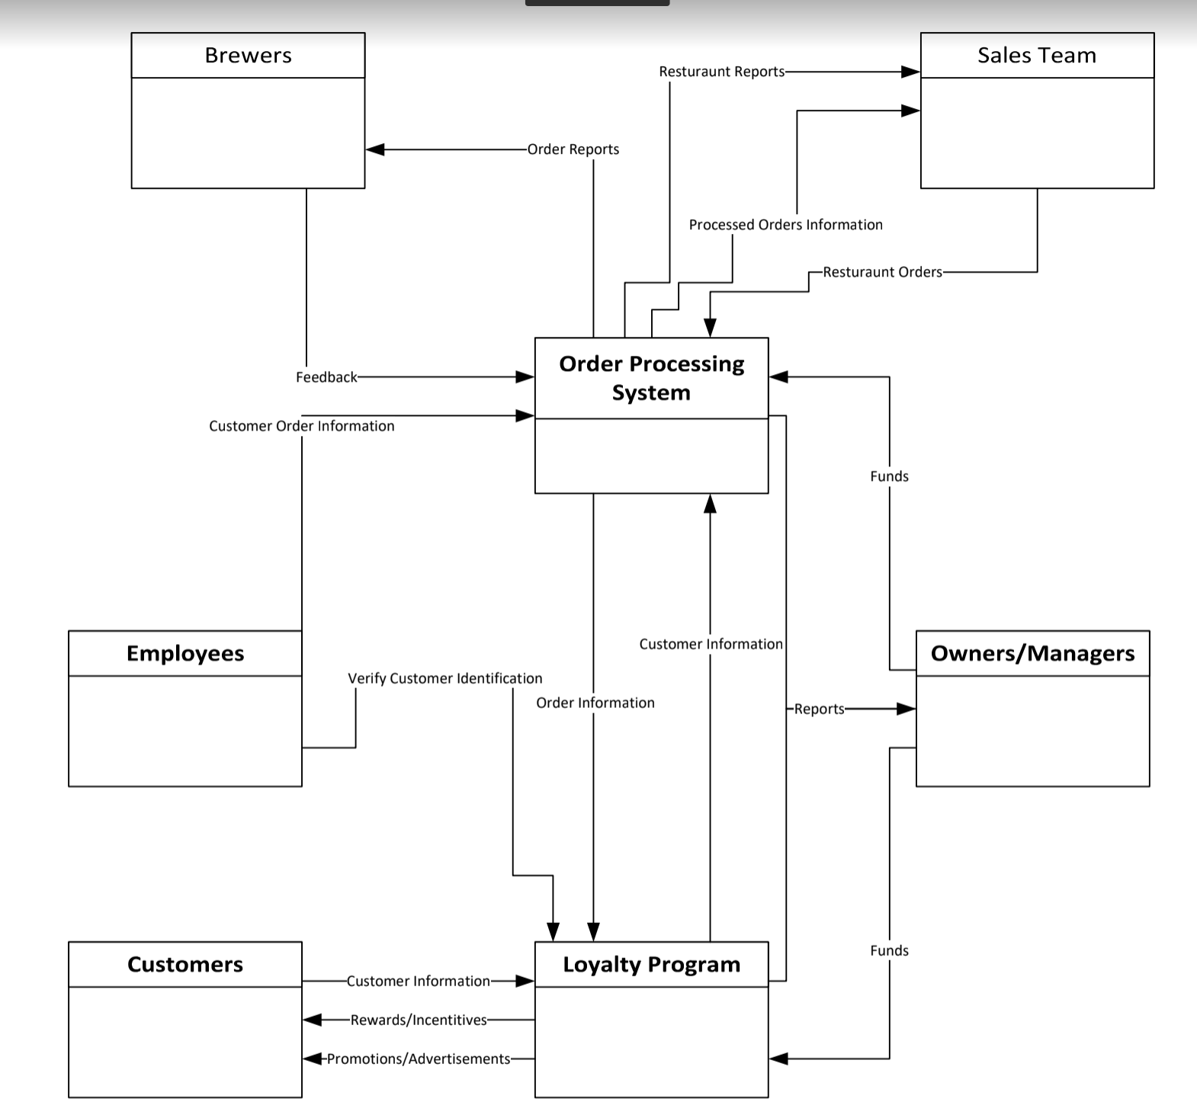
SCOPE DIAGRAM
Notes:
Chantera
This is our Scope diagram. I will not focus on all aspects of the diagram, but I will note the order processing system and loyalty program in the middle that we are trying to implement. Next the employees and customers.. Finally the owners/manager.
Moving on to the next slide which covers the objective list

Slide 13
CURRENT SYSTEM DESCRIPTION
Klaus Brewing Company does not have a loyalty program in place nor a way to get in contact with clients. They don't have a system which assigns specific ID to each customer along with saving customer order history and details.
The scope of our project pertains to the systems involved in the taproom. Klaus Brewing Company does not have a loyalty program in place nor a way to contact clients.
The taproom is over-serving customers. Their current system within scope includes a system which is employed to sell customers merchandise and/or bier. The order is placed via the POS system.
The customer has the option of keeping a tab open or paying now.
If a customer chooses to keep a tab open, they will hand the biertender their credit card which is filed by the last name. When they want to close the tab they will go back to the biertender, give their name, and finish paying.
If they pay now, the customer just hands the biertender their method of payment.
There are three methods of payment: cash, credit card, and tokens.
Tokens are sold in pairs of two and three. A customer buys tokens and they are allowed to cash them in for any core beer which is Klaus Brewing Company’s main bier.
Once they finish making their payment they will receive a receipt.

Slide 14
CURRENT OBJECTIVES LIST
Main Objectives
To design and offer a graphical user interface application with an SQL database system for Klaus Brewing Co.
To develop a customer loyalty program that is more pleasing to ownership and new customers.
To allow more customer interaction with incentives discovered through the system.

Slide 15
CLIENT APPLICATION (SYSTEM) OBJECTIVE LIST
To create a computerized order processing system in a way that ensures a 100% increase in data storage efficiency so that employees can access information on products and customers faster. Can be measured by the number of taproom employees who can successfully use the system.
To create a loyalty rewards program in a way that helps reward customers that return so that we get a 20% increase in customers that keep buying products from Klaus Brewing. Can be measured by the number of increased customers that register for the loyalty program.
Notes:
Chantera
The two main objective is to create an order processing system that increased data storage efficiency. It will be measured by the number of employees that can successfully use the system.
The second objective is to create a loyalty rewards program that keeps track of repeat customers which can be measured by the increased number of registered customers in the database
Moving on to the ind user’s objective list

Slide 16
INDIVIDUAL USERS OBJECTIVE LIST
Brew master
Data entry to be computerized and stored, and for data entry to be simplified. Uniformed data format for each department to use.
Taproom Manager
Computer access to the system and fluidity of the app.
Ability to see up-to-date readings of inventory on hand.
Ability to place orders at notified time
Encourage more customers to return
Bring in more of the younger adult crowd
Sales Manager
Ability to get notifications of recurring customers.
Ability to connect to a larger customer base (use forms)
Bartender & Brewers
Ability to see up-to-date readings of inventory on hand.
Ability to place orders at notified time

Slide 17
STROBE ANALYSIS
Klaus Brewing company hosts a friendly laid-back environment where group of people come to enjoy beer, play games, and conversate. ​
They offer many areas including the Brewery, the Garden area, and the main taproom area. Workers have to attend to their daily activities as well as manage the counter. Most information is written on boards and events are posted around the establishment. They have a steady flow of customers so in often observed cases, the taproom employees are multitasking or taken advantage of their free time.
Notes:
Chantera
Our company hosts a friendly laid back environment that allows customers to congregate, drink, play games, and talk.
Offers many areas including the Brewery garden area and main taproom.
Moving on to the brewery slide
Going to the Brewery slide.

Slide 18
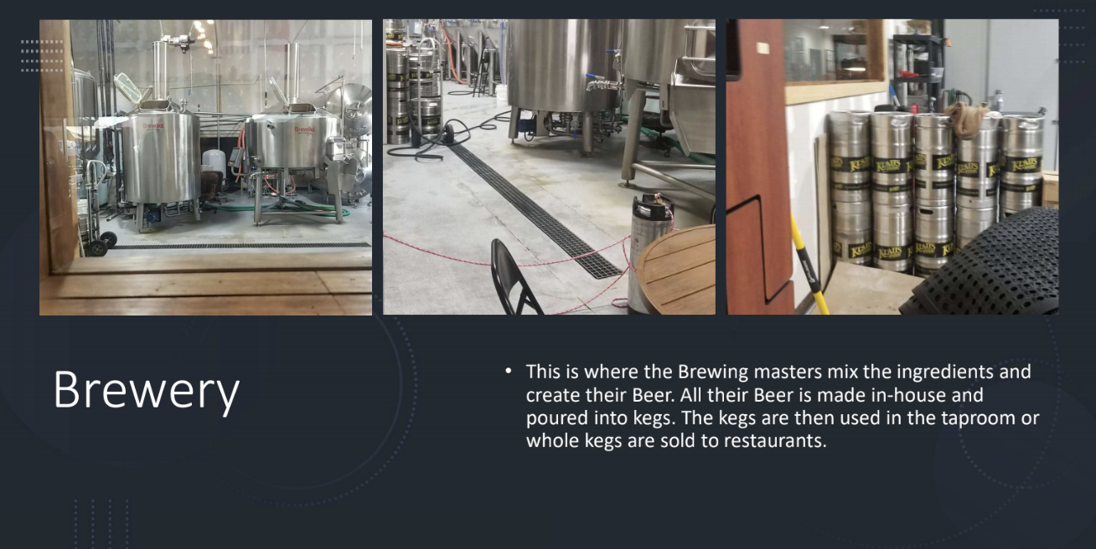

Slide 19
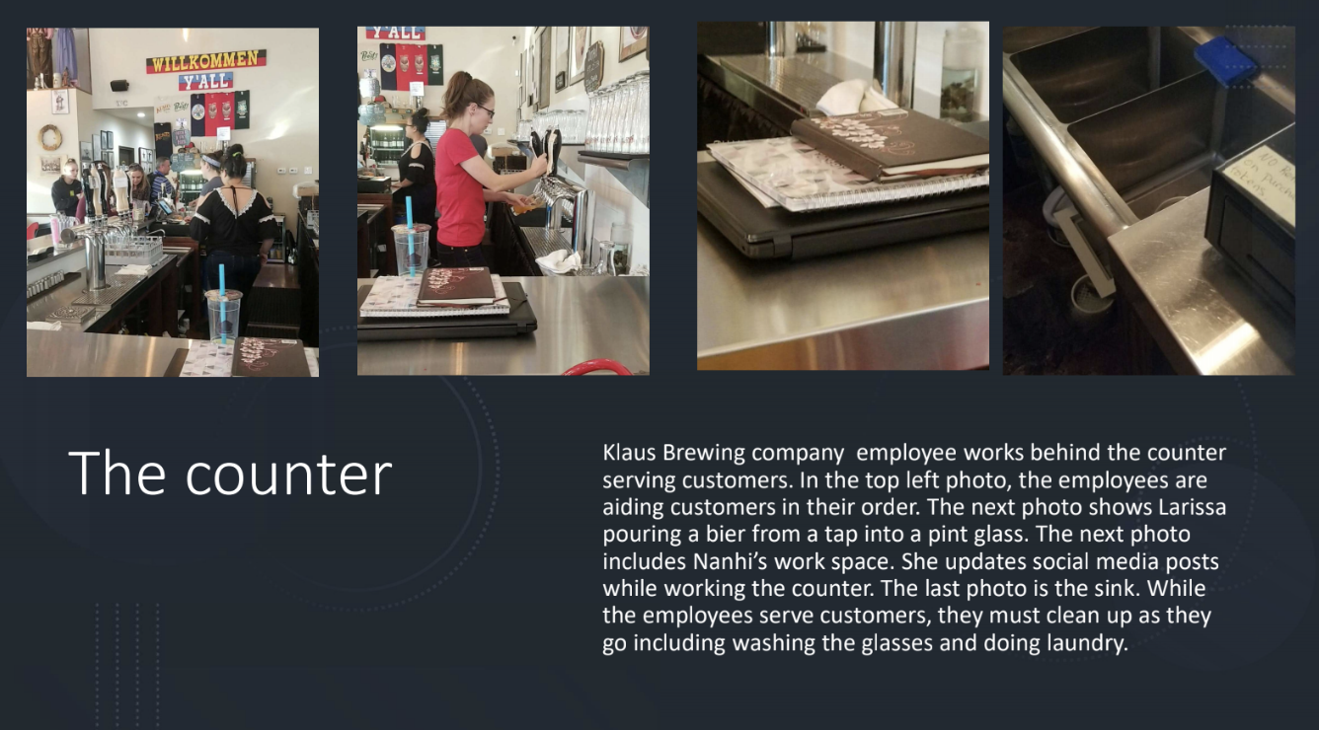
Notes:
Chantera
The counter is very important. Highlights customer and employee interaction as well as the many employee tasks. It also highlights the taproom manager environment. I also want to point out her office is right next to the counter.
Moving on to the GANTT chart

Slide 20
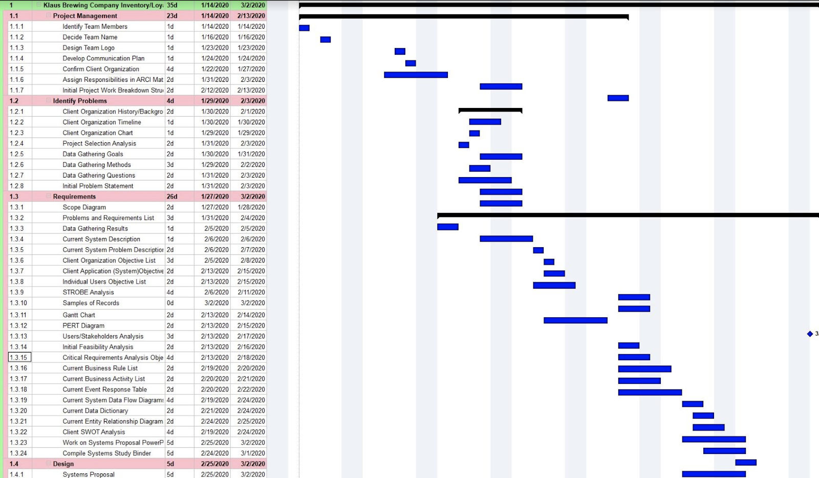
GANTT CHART

Slide 21
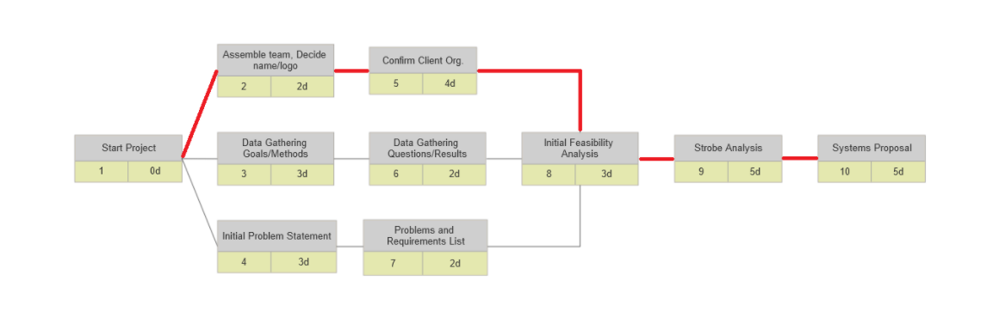
PERT CHART

Slide 22
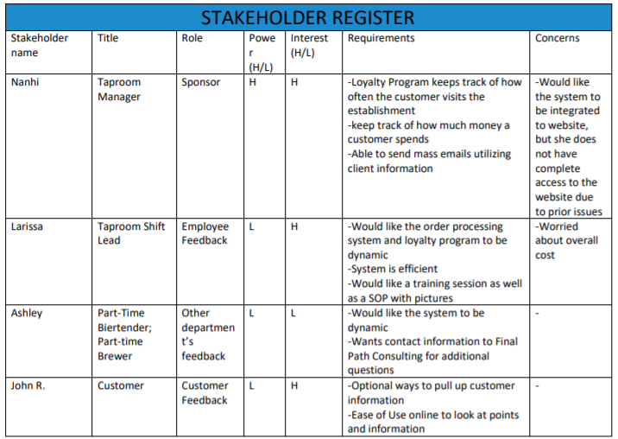
USERS/STAKEHOLDER ANALYSIS
Notes:
Chantera
Stakeholders
Nanhi-Owner/Taproom Manager; Requirements- keeps track of customer visits, how much customer spends, allow her to send mass emails.
Larissa-Shift lead: system is efficient and require a very detailed and organized training
Ashley-Biertender and Brewer;dynamic system to build upon; wants contact information for technical issues
John-Customer: ease of access specifically an easy way to access customer information
Initial Feasibility Analysis

Slide 23
INITIAL FEASIBILITY ANALYSIS
Technical
We have found that our client is going to need at least 2 dedicated PC’s or a tablet that will have the capability of connecting to a server. With that the client needs a -data server being cloud based or an in-house system.
Operational
The main thing to look for is the technical prowess of the workers who will utilize the system. If they can be properly taught the system for use. Then can the new system hold information needed by the client for inventory needs and scheduling needs.
Economical
our client will need to acquire a database to hold the data and files of their business. That we either incorporate a cloud-based server or an in-house option. They can either rent or buy a server. By renting the server for one fixed monthly price from a service provider like ServerMania or Microsoft Azure, Or purchase a server from a company like Dell and store it in their office.
Scheduling
The scheduling feasibility is used to gauge the time in man/labour hours needed to fulfill the application development and training needed to make sure the project was a success. So we figured this by measuring the time it would take to develop the platform based on the feedback given in interviews and we relayed that information with the option giving in different levels stated above. With this we understand what amount of time will be needed to allot for man hours for completion.

Slide 24
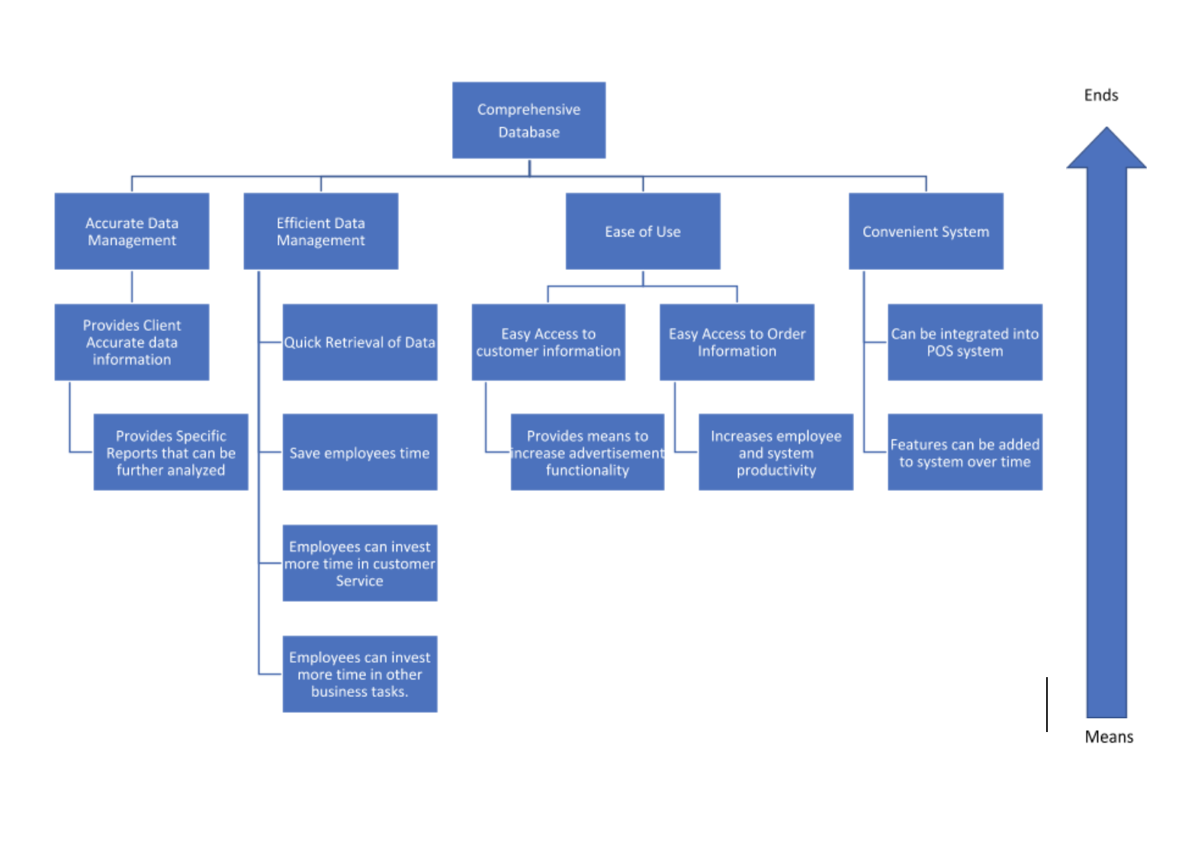
CRITICAL REQUIREMENT ANALYSIS OBJECTIVE TREE

Slide 25
CURRENT BUSINESS RULE LIST
If a customer buys any glass, their first fill is free.
If a customer forgets their credit card, Klaus will close their tab and automatically charge 20% gratuity on the bill.
Tables cannot be reserved unless the customer pre-purchases a package.
On Thursdays, customers can bring in their own Stein for a free fill. However, the fill is limited to only one liter.
If customers want to participate in any event (trivia, bingo, comedy night, or etc.), they must purchase at least one bier.
Tokens can be exchanged for one pint of a core bier. Tokens do not have expiration dates.
Notes:
Chantera
This is our client’s Current Business List that is implemented at our client’s’ facility that we wanted to keep in mind when making our system.
To point out a few rules
customer forgets their credit card, klaus brewing company closes the tab and adds 20% gratuity
Stein night: customer brings a stein and they get free drinks up to a liter.
Tokens can only be exchanged for one pint of core bier and does not expire
Moving on to the current business activity list

Slide 26
CURRENT BUSINESS ACTIVITY LIST
Daily Taproom Activities
Prepare Taproom for the day by following normal opening protocols
Set up Beer Garden (including umbrellas and outside games)
Serving Beer, wine, or soda to Customers
Weekly Taproom Activities
Inventory is taken
Deep Clean taproom and beer garden following Sunday Deep Cleaning Checklist
Manager Meetings (All managers and Owners)
Sales Meetings (Sales Manager, Sales Team Members, Owners)
Yearly Taproom Activities
Oktoberfest
Maifest
Inspections
Safety Infections
TABC compliance audit

Slide 27
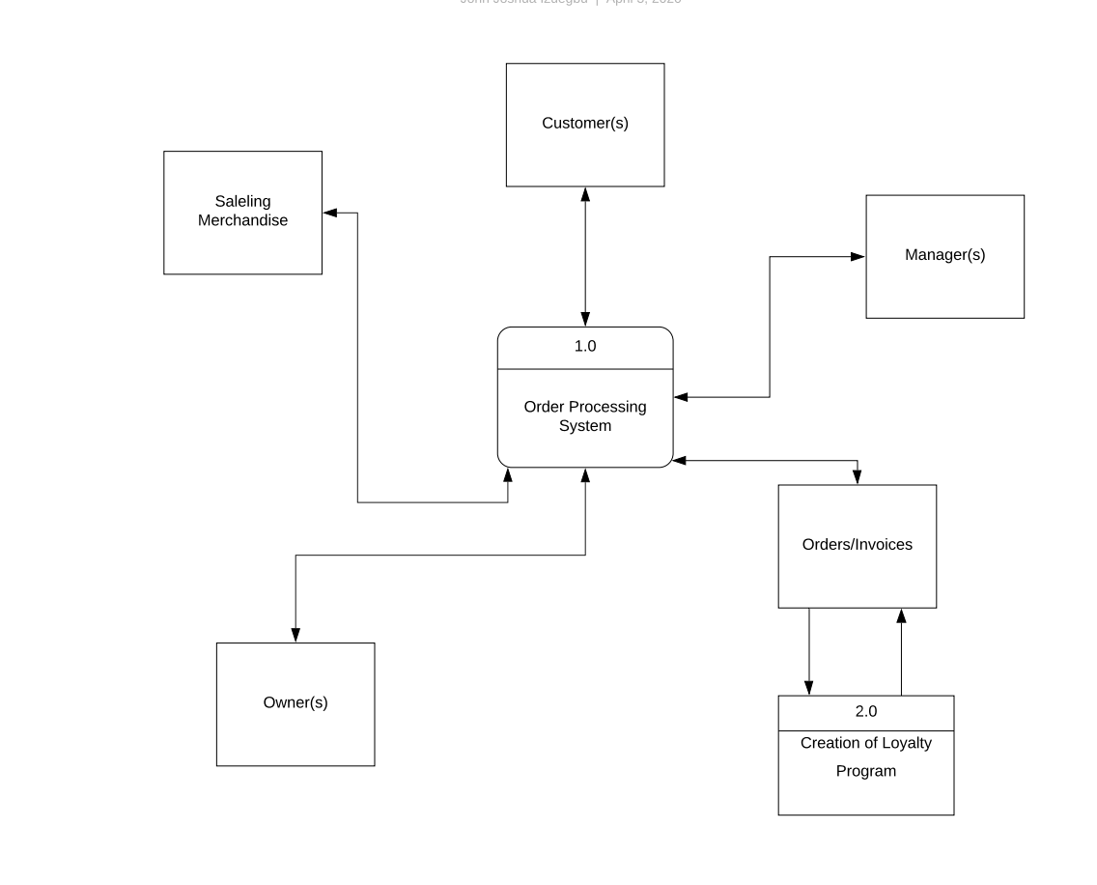
CURRENT DATA FLOW DIAGRAM (LEVEL 0)

Slide 28
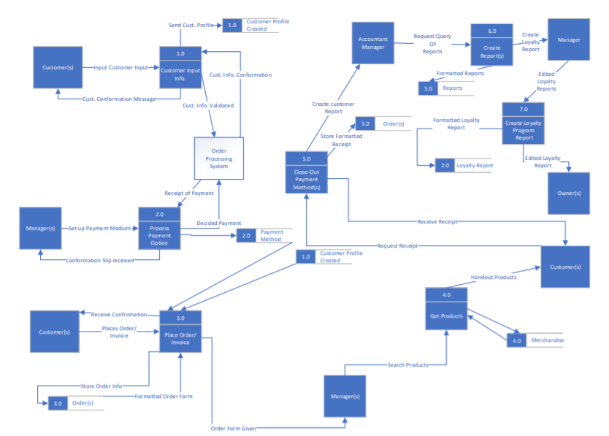
CURRENT DATA FLOW DIAGRAM LEVEL 1

Slide 29
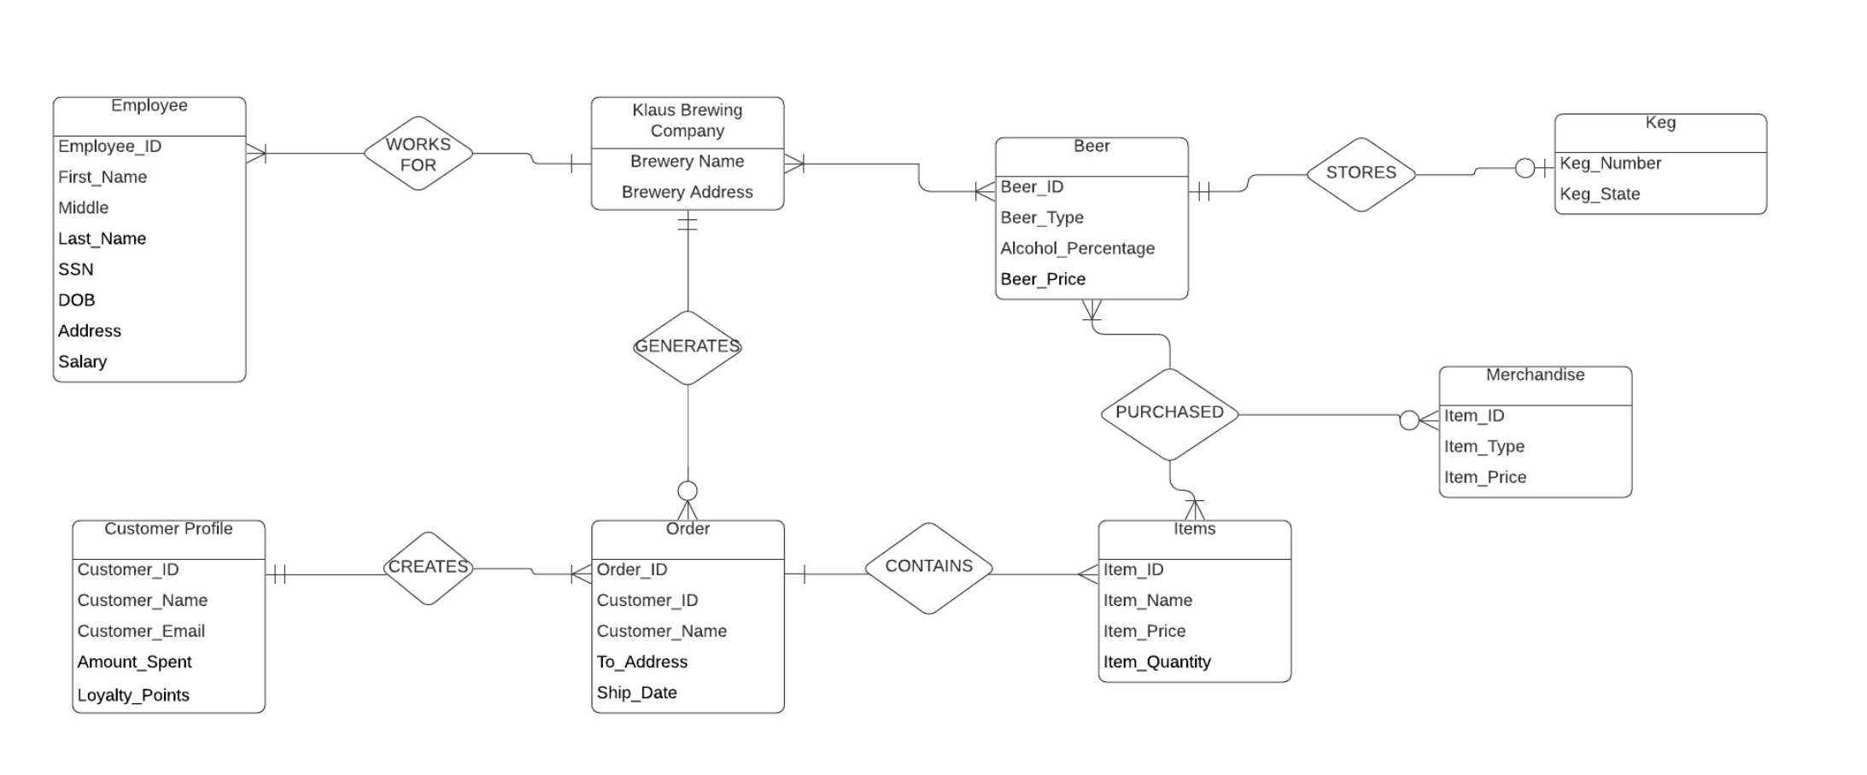
CURRENT ENTITY RELATIONSHIP DIAGRAM

Slide 30
CURRENT EVENT RESPONSE TABLE
Event | Response
Prepare Taproom for the opening | Taproom managers and employees come in early to set up beer gardens, games, and set up chalk-boards with daily specials or events of the day.
Serving Customers | Biertenders choose what the customer requests via the POS system and charges the customer. Then hand the customers their paid items which could be Beer, wine, soda, or merchandise.
Customer inquires about food | Biertenders direct customers to Food Trucks available on the premises.
Event night | Biertenders and Taproom managers set up events. Then gives customers a countdown timer so they settle in and participate if they want.
Keg Changes | If kegs become defective, Kegs are switched out via the Bartenders or Taproom Manager.
Cleaning | Laundry, dishes, and cleaning is done periodically by Biertenders during business hours and at closing time.
Prepare Taproom for Close | Taproom Managers and Biertenders follow closing protocol to close down operations for the night.
Inventory | Mary-Lou takes inventory by checking on merchandise that she feels is subjectively low and needs to be ordered.

Slide 31
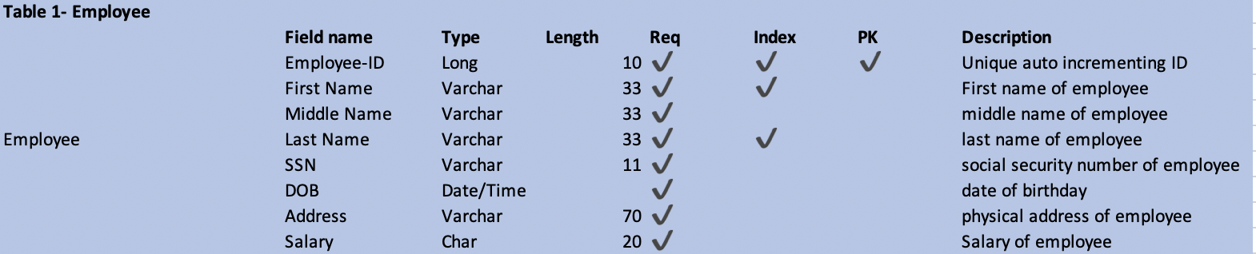
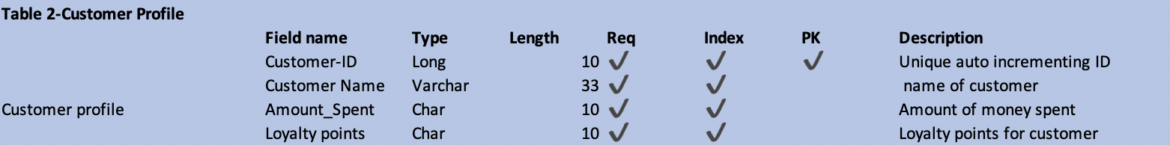
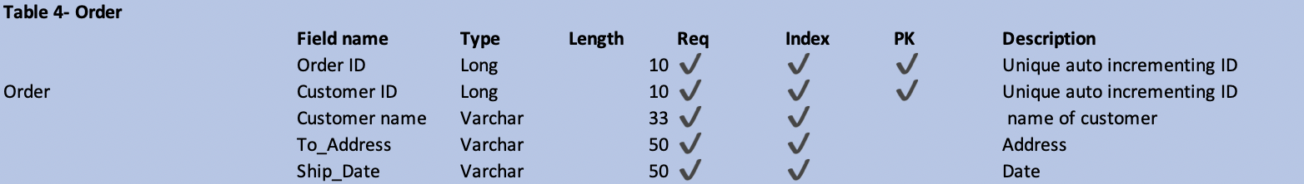
CURRENT DATA DICTIONARY

Slide 32
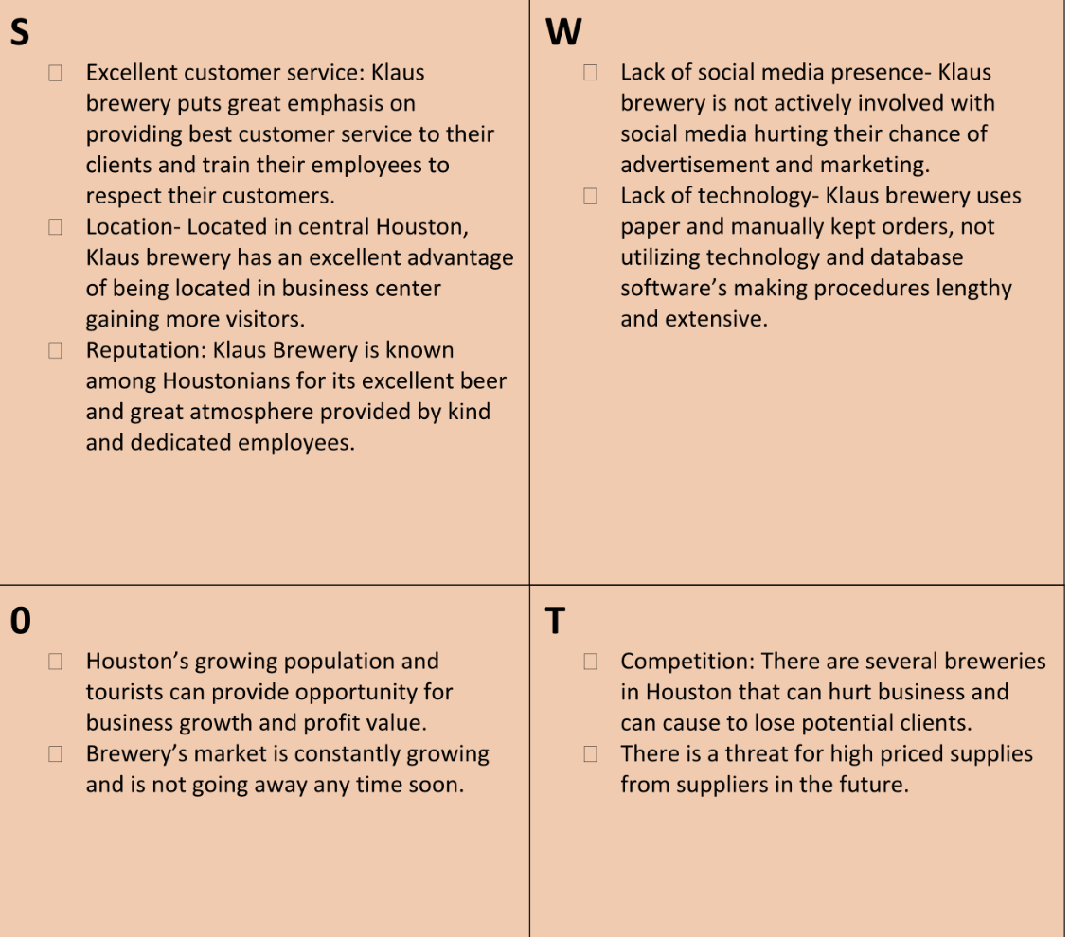
CLIENT SWOT ANALYSIS

Slide 33
OUR SYSTEM PROPOSAL
Option 1
A system that creates an Order Processing system which itemizes merchandise including bier, glasses, gift sets, to-go bottles, sodas, wines, hats, and t-shirts. The system will then keep track of customer orders and purchases each day. The system will have the potential to grow as the new company grows which may include adding a shipping feature for their merchandise or integrating with a future inventory system. We are also proposing to create a system that will function as a database for customer data and relates it to how much money they spend, the merchandise they have purchased via the Order Processing system and how often they visit the Client’s site. This system will also hold information on how long the customer has been a member of Klaus Brewing Company. Data from the database system will assist in creating a loyalty program that rewards returning members’ incentives and benefits regarding the program. This system will be integrated into their POS system as their website so they can easily transition into using our system.
Option 2
A system that creates an Order Processing system which itemizes merchandise including bier, glasses, gift sets, to-go bottles, sodas, wines, hats, and t-shirts. The system will then keep track of customer orders and purchases each day. The system will have the potential to grow as the new company grows which may include adding a shipping feature for their merchandise or integrating with a future inventory system. We are also proposing to create a system that will function as a database for customer data and relates it to how much money they spend, the merchandise they have purchased via the Order Processing system and how often they visit the Client’s site. This system will also hold information on how long the customer has been a member of Klaus Brewing Company. Data from the database system will assist in creating a loyalty program that rewards returning members’ incentives and benefits regarding the program. This system will be a standalone system and will be integrated into their current POS system but not their website. This will be beneficial if they have to change their website database.
Notes:
Chantera
We knew we wanted to create the basis of an order processing system which itemizes merchandise and bier as well as a database for customer data. This will allow us to track customer orders and purchases and allow the clients to keep track of how often the customer visitied, and how much the customer spends.
The difference in the two options are would we integrate the application into website or create a separate database.
Moving on to Phase II

Slide 34
PHASE 2

Slide 35
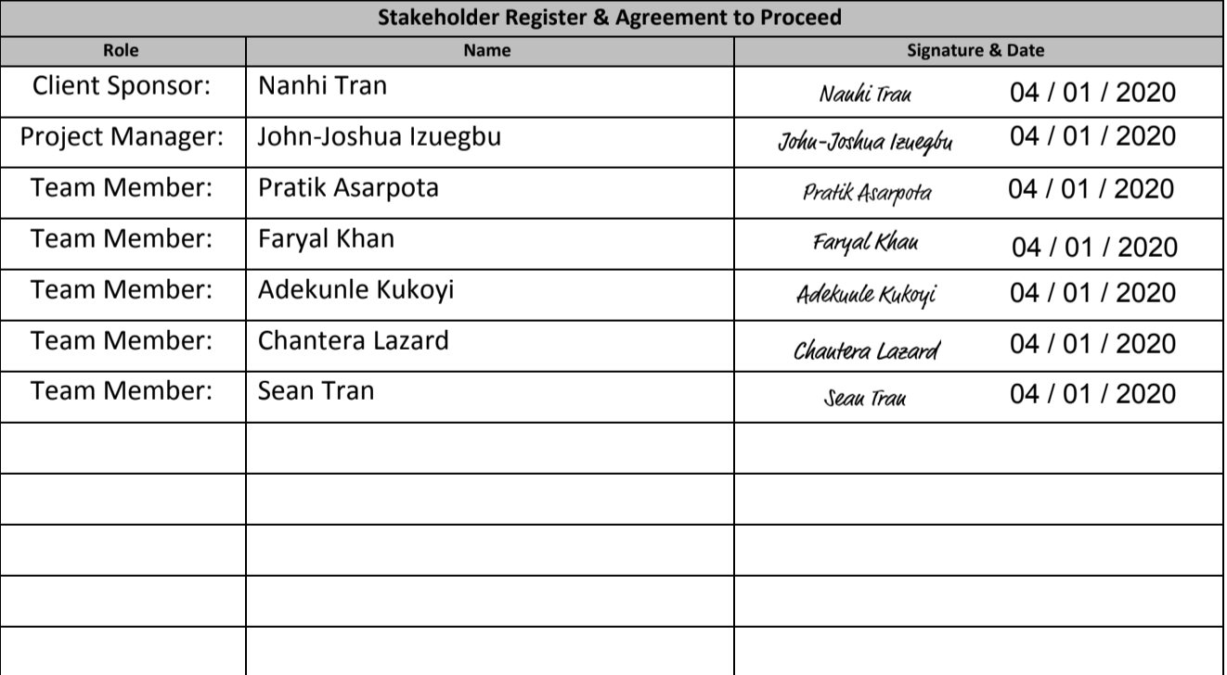
INITIAL STAKEHOLDER REGISTER & AGREEMENT TO PROCEED
Project Team members understand that they have an obligation to work with the client to deliver a ‘best effort’ MS Access product which satisfies both: Client requirements (which will be defined in the Requirements Traceability Matrix), Class requirements (as defined in the Project Requirements document);
Client Sponsor authorizes the Project Team to begin working on a Statement of Scope, Work Breakdown Structure and Work Plan, which will provide an overall structure for managing the software development effort.
Notes:
Chantera
Decided to make separate application because our client let us know they do not have complete control of their website. We agreed to deliver our best work with our client’s requirements in mind. Klaus understood our analysis, our agreement, and authorized us to move forward.
Moving on to the updated version of Klaus Brewing Company background

Slide 36
UPDATED CLIENT BACKGROUND INFORMATION
Klaus Brewing Company was founded by a local group of family and friends led by passionate brewer Thomas Lemke. Focused on bringing the under-served German-style beers to a wide range of consumers, from beer aficionados to new converts alike. They chose the name Klaus because they wanted a strong traditional German name. The name's meaning is "The People’s Victory". The company feels being able to offer people the ability to experience great locally crafted beer in a welcoming environment is truly a victory for everyone.
Recently, during the first quarter of 2020, a global pandemic took place due to which countries, cities, states nation-wide were all on a lockdown. This event had negatively affected a lot of people’s jobs and livelihoods. Some were fortunate, others not so much. Unfortunately, Klaus Brewing Company was negatively affected by this disaster and was forced to fire the entire lower level employees – Biertenders, Brewers, and the Sales Rep. They were only able to keep the managers employed.

Slide 37
CONTINUED UPDATED REQUIREMENT LIST
Ref Number | Problem Description | Source | Date | Priority (M, K, D) | Rank | Requirements Description | Current Perfor-mance (Excellent, Fair, Poor) | Required Perfor-mance | Scope ("in" or "out")
2 | Upload spreadsheet form of merchandise and beir | Nanhi | 02/16/2020 | M | 5 | Solution allows for uploading of current spreadsheets | P | E | In
3 | Loyalty Program creation | Nanhi | 11/6/2019 | M | 7 | Solution allows for tables to be created depicting customer lastingness in brewery and what was purchased | F | E | In
1 | Electronic access to resources | Nanhi& Group | 02/10/20 | K | 1 | Create solution that allows company to access any forms, reports, customer info and order holdings online | P | E | In
4 | Forms to handle customer profiles | Group & Nanhi | 02/16/2020 | K | 3 | Solution allows customer to input data and create profile from information | F | E | In
6 | Pull up Customer Loyalty Report | Nanhi | 11/6/2019 | K | 4 | Solution allows ET to pull up any and all completed reports and tables of customer info related to purchased items | F | E | In
5 | Live update of merchandise tracking | Nanhi | 02/16/2020 | D | 8 | Solution allows client to see up-to-date readings of merchandise and orders from client to customer. | P | F | In
7 | Email notification of deals to Customers | Nanhi | 03/18/2020 | D | 8 | Solution allows for clients to send out email vouchers and deals, and give the customer the ability to sign up for a newsletter from the client. | F | P | Out
9 | Website Integration | Nanhi | 03/20/2020 | P | 5 | Solution allows for client to access the system through the company online website. | F | F | TBD
10 | Loyalty Program Rewards Criteria | Final Path Group | 04/04/2020 | M | 8 | The business rule is defined for the the different incentives given by the creation of the loyalty program. | P | E | In

Slide 38
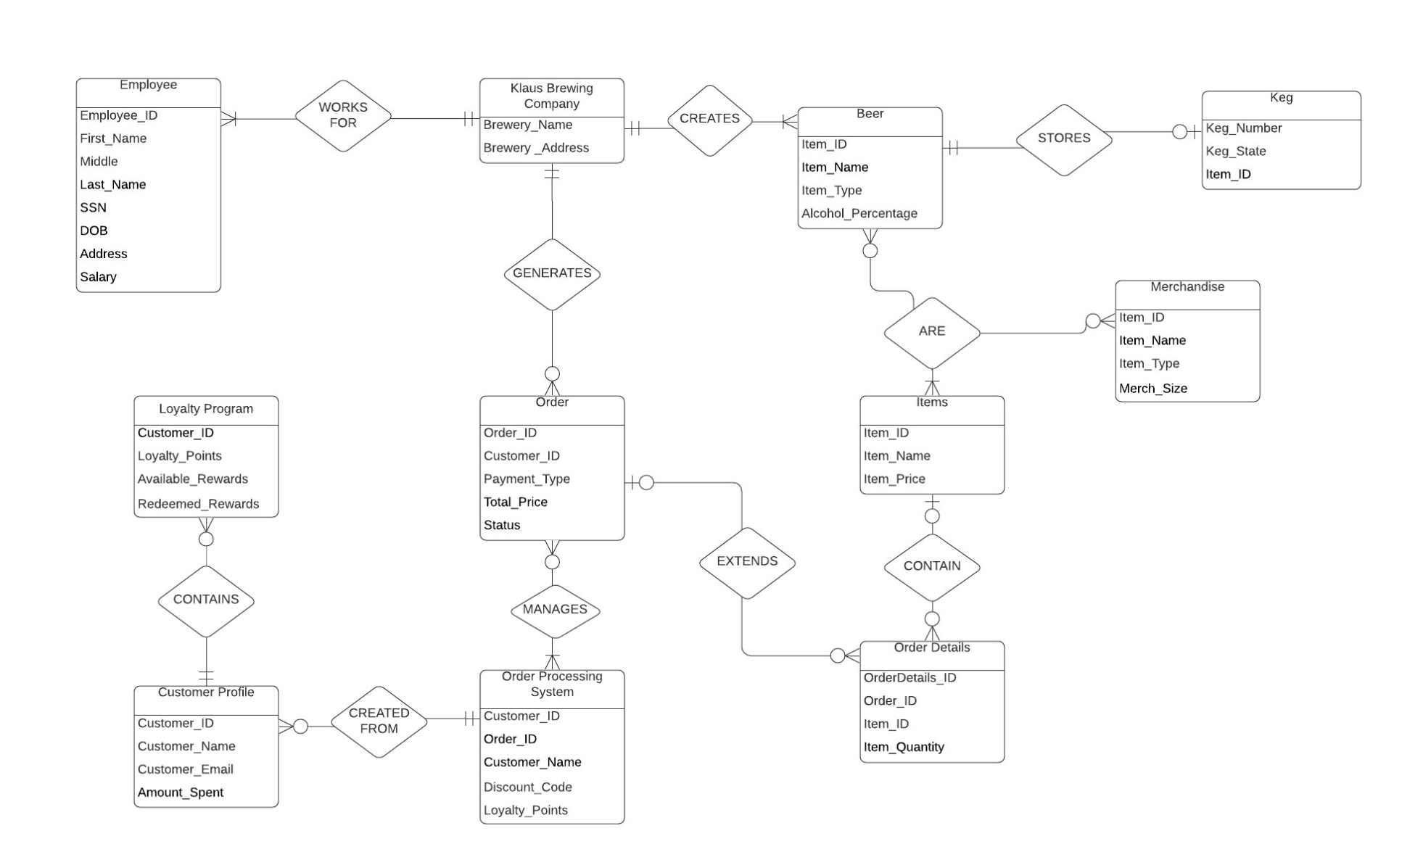
REQUIRED SYSTEM ERD

Slide 39
REQUIRED BUSINESS RULE LIST
For each customer that comes in the brewery and makes a purchase, their purchase has to be recorded in their customer profile assigned to them according to the loyalty program.
For each $7 that a customer spends, they receive 1 point in their profile.
Whenever a customer makes a purchase, whoever is working as a cashier at the moment is required to ask the customer for their email address or phone number and see some sort of photo id as well if the purchase regards any sort of alcohol.
Its mandatory for employees to add customer purchases so they can later be awarded rewards programs later.
For a customer that qualifies for a loyalty reward program, the cashier will ask them that they have an option whether to save their points for a bigger discount in the future or use the current points for a discount on the current day.
If an employee returns any merchandise that they have purchased, it won’t affect their rewards points and points won’t be taken away from their customer profile.
Employees are required to constantly update any sort of additional data or address changes to customers profiles in the database.
Notes:
Chantera
Business Rule List-not exhausted. We do not have all rules because our client had limited time to talk through this with us due to COVID-19 issues, but this is what we agreed on so far.
Customer Purchase should be recorded so as to update the loyalty program
employee has to prompt for customer information to access customer profile
7 dollars = 1 point
returns will not affect points.
Employees and customer should always make sure information is updated.
Moving forward to the CRUD Matrix

Slide 40
REQUIRED SYSTEM ACTIVITY LIST
Daily Taproom Activities
Prepare Taproom for the day by following normal opening protocols
Set up Beer Garden (including umbrellas and outside games)
Requesting if customers are loyalty members or not
If a member, the taproom employees prompts the customer to login to their account via phone number or email address.
If the application is down, the taproom employees prompts the customer to keep the receipt and go online and login to the account. Add receipt number in a limited timeframe and the order would go against loyalty rewards.
If not a member, the taproom employees prompts the customer to go online and fill out a form to become a member.
If the application is down, the taproom employees prompt the customer to keep receipt and set up a profile later. Put the receipt number in in a limited timeframe and the order would go against loyalty rewards.
Notes:
Activity List the major difference is in the daily tasks.
The employee has to prompt if the customer is a loyalty program member or not. If they are prompt for email or phone number. If not and prompt customer to sign up.
IF new customer and if the employee cannot bring up customer profile in store, the customers have option to keep receipt and for a limited time can either sign up if new customer or sign in if returning customer and add receipt number to incrue points.
Moving on to CRUD matrix

Slide 41
REQUIRED SYSTEM CRUD MATRIX
 | Set Employee Privileges | Beverage Reports | Access Report System | Merchandise Reports | Quarterly Sales Reports | Loyalty Progam Reports | Access Employee Details | Access Customer Details
Owner (CEO) | CRUD | R | RU | R | R | R | CRUD | RUD
Taproom Manager | CRUD | CRUD | CRUD | CRUD | CRUD | CRUD | CRU | CRUD
Beirtenders | ---- | R | R | R | ---- | R | R | R
Sales | ---- | CRU | CRU | CRU | CRUD | CRU | R | R

Slide 42
REQUIRED SYSTEM EVENT RESPONSE TABLE
Event | Response
Prepare Taproom for the opening | Taproom managers and employees come in early to set up beer gardens, games, and set up chalk-boards with daily specials or events of the day.
Serving Customers | Biertenders ask customers for their phone number or email so that the customer’s purchase can be tracked by the application provided by finalpath, for the loyalty program. Then biertenders choose what the customer requests via the POS system and charges the customer. Then hands the customers their paid items which could be Beer, wine, soda, or merchandise.
Customer inquires about food | Biertenders direct customers to Food Trucks available on the premises.
Event night | Biertenders and Taproom managers set up events. Then gives customers a countdown timer so they settle in and participate if they want.
Keg Changes | If kegs become defective, Kegs are switched out via the Bartenders or Taproom Manager.
Cleaning | Laundry, dishes, and cleaning is done periodically by Biertenders during business hours and at closing time.
Prepare Taproom for Close | Taproom Managers and Biertenders follow closing protocol to close down operations for the night.

Slide 43
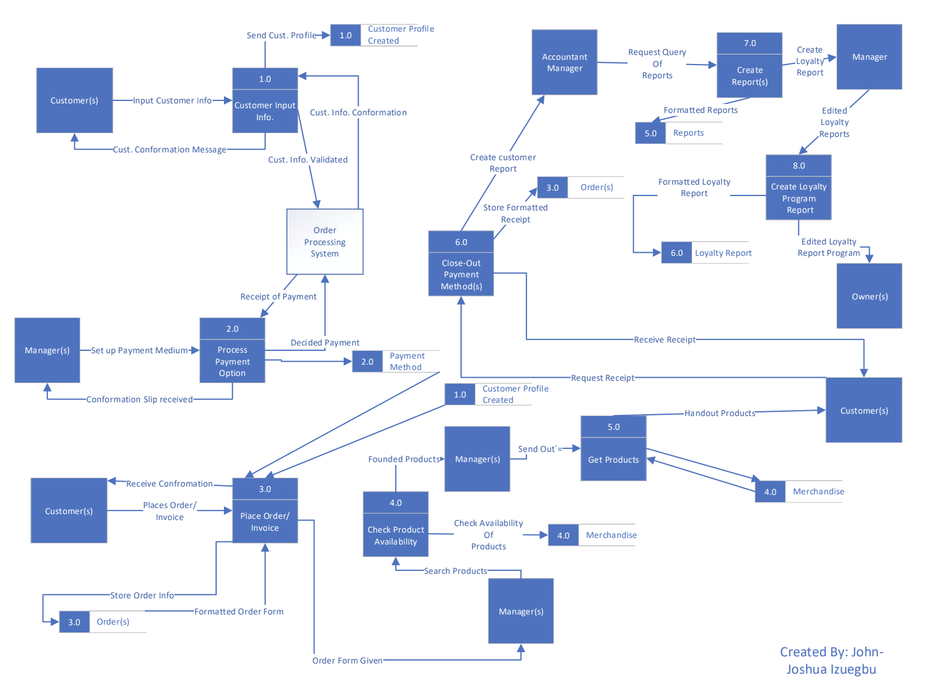
REQUIRED DATA FLOW DIAGRAM

Slide 44
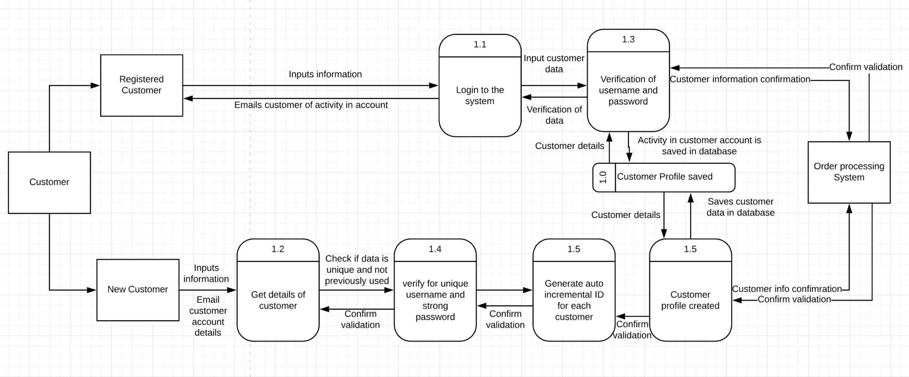
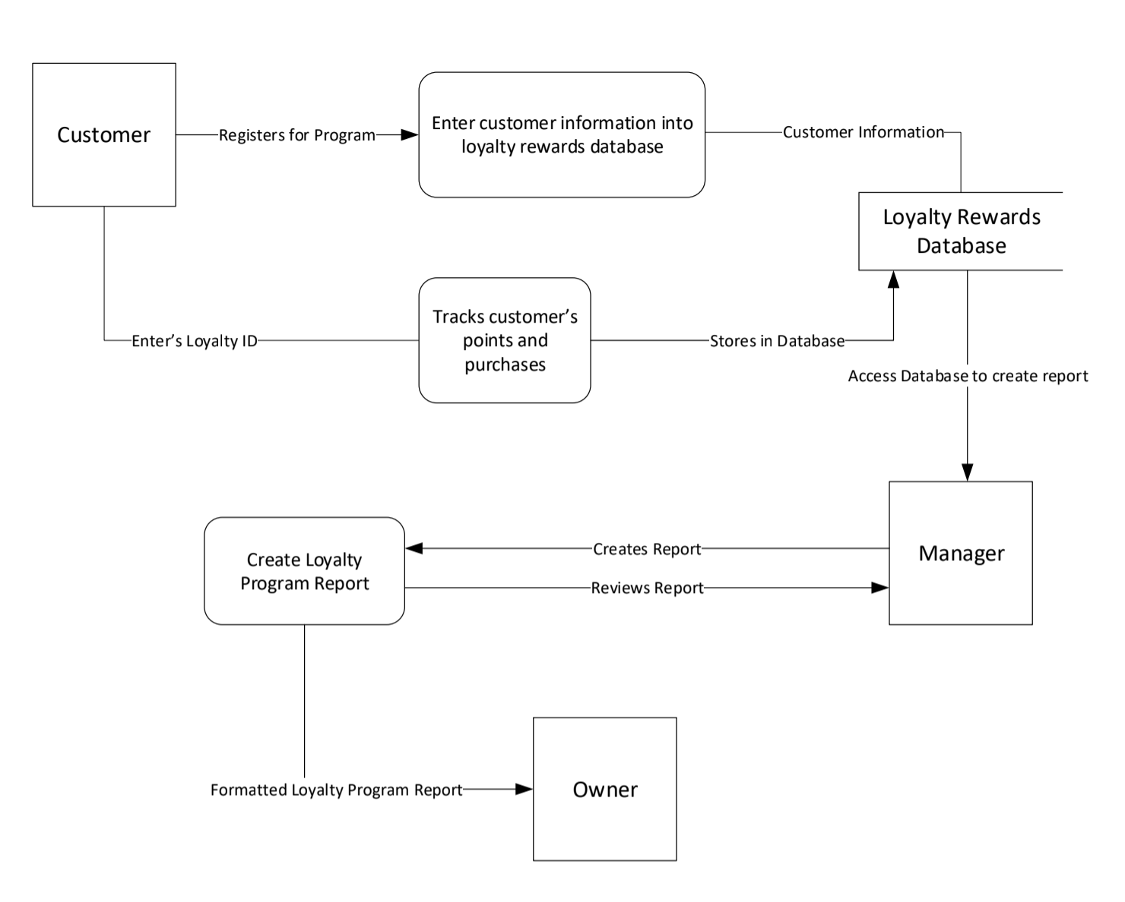

Slide 45
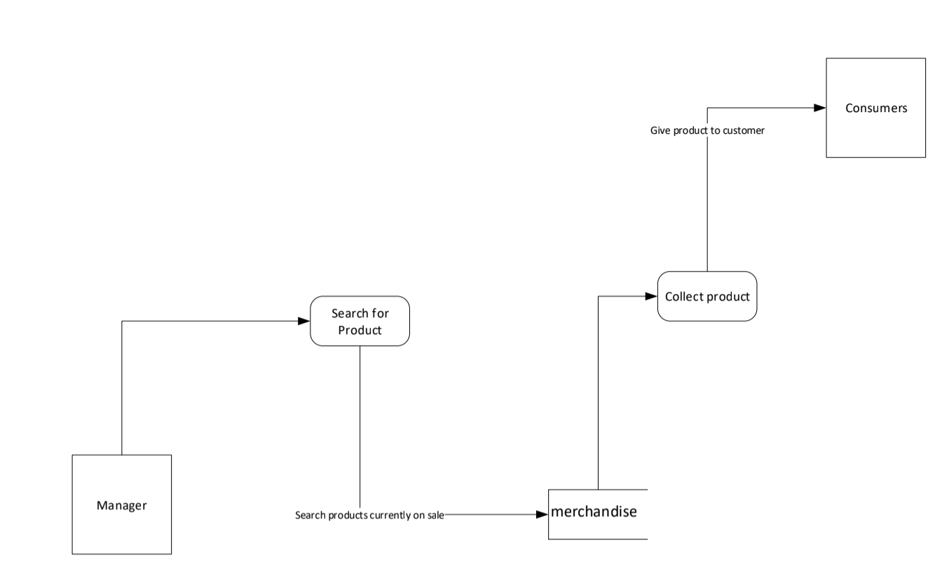
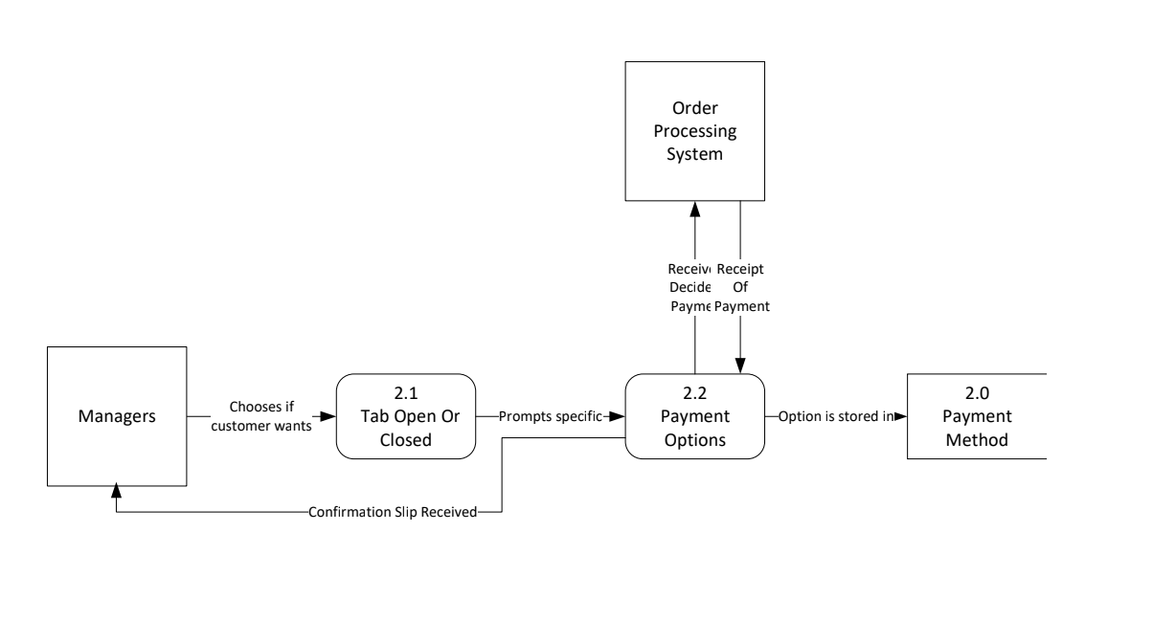
Notes:
Chantera
I focused on the payment options process.
So the manager has to tell the system if the tab will be opened or closed which will allow for certain payment options. Once payment option is chosen it will be stored and the information will be sent to the order processing system. The system will process the information and send confirmation to the manager if the payment option was processed.

Slide 46
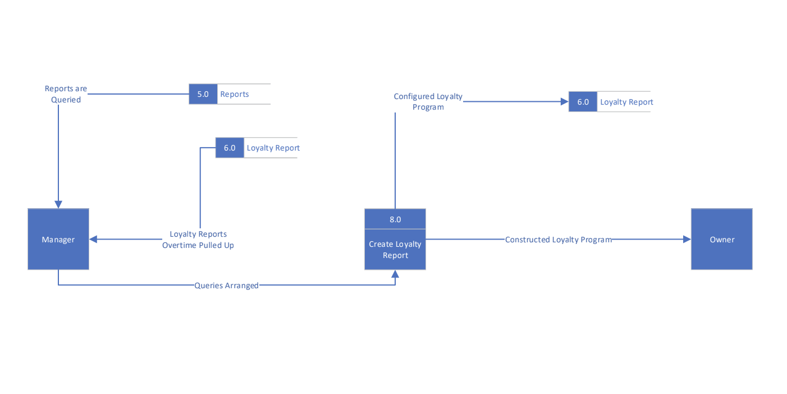
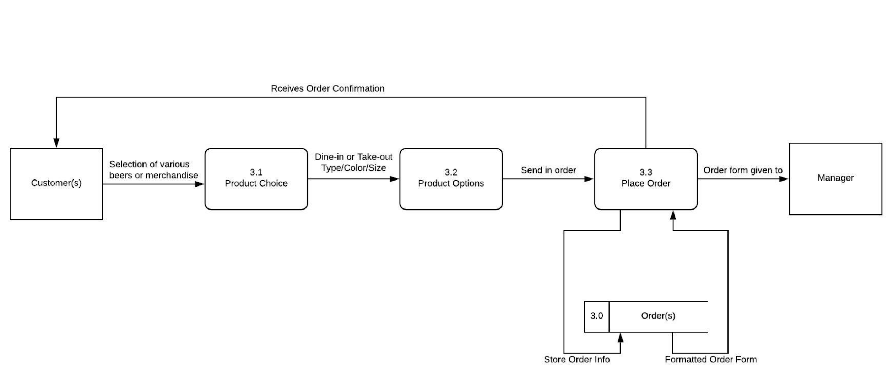

Slide 47
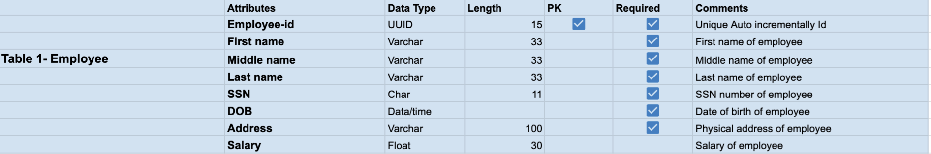
REQUIRED DATA DICTIONARY

Slide 48
FEASIBILITY ANALYSIS
Technical Feasibility :the technical feasibility analysis was based on the company’s current resources (hardware and software) and technology that are required to accomplish the user requirements within the allocated budget and time. For this, we had to check whether the current technology could be upgraded with our proposed solution being added onto the current system, or if we would have to develop a new, independent system.
Economic Feasibility:The economic feasibility analysis was based on whether the required solution is capable of generating any financial gains for the organization. It included costs incurred on the software development team, estimated hardware and/or software costs, cost of performing a feasibility study, cost of training employees and so on.
Operational Feasibility:The operational feasibility analysis was based on assessing the extent to which the required solution performs a series of steps/tasks to solve business problems and user requirements. Our proposed solution will not require too much time to educate the employees, as it is essentially an upgrade that will not drastically change the current system and will be fully functional and ready to be used as soon as implemented. The recommended solution will be heavily used on a daily basis to help employees perform daily operations in a more efficient manner. Therefore, our proposed solution has a high probability of being implemented.
Scheduling Feasibility:The scheduling feasibility analysis was based on estimating the time required for completing the project. This is done by measuring the time required for the development of the system, which is based on the system requirements. Through this, efforts are made from our team to allocate manpower to their respective tasks which allows us to ensure completion of the project within the deadline.

Slide 49
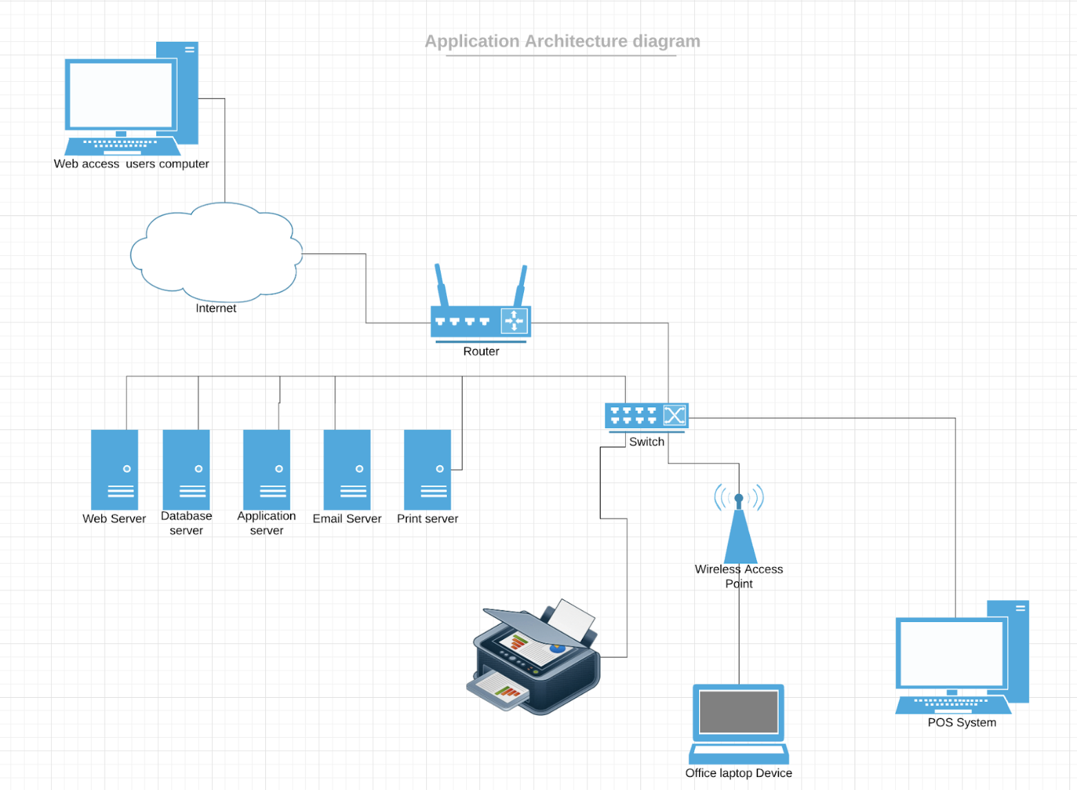
APPLICATION ARCHITECTURE DIAGRAM

Slide 50
DATA ACQUISITION & CONVERSION STRATEGY
Klaus Brewing Company currently stores and files their customer and merchandise data in paper files in multiple folders and a point-of-sale system that is linked to transactions by said customers. The transactions are held in the front two computers in the taproom at the facility. Once paper files become old and outdated in regards to management they are filed in file cabinets in the facility. In order to fully convert to the new proposed system, the older files that are stored in the cabinets will need to be converted into digital format.
With the use of scanners and tri-copied receipt material, the documents will be filed in the system to be accessible on the computer. Depending on the type of file, the document will be saved as is in the system. The saved electronic files will be then converted into a text file, and formatted to the conditions we will have set for the client information in the database. Due to the amount of files needed to be converted and stored, the use of external hard drives or the cloud is needed.
After conversions of old paperwork is completed then, we will have to transfer over customer and transaction information from the client’s POS (Point-of-Sale) system. We will have to convert the document cover to an excel document then to import into our system to populate the tables and queries. Finally, the use of an SQL database to store and format the data will be occur.

Slide 51
INITIAL DRAFT OF TESTING PLAN
One of our tests will be on whether the customer’s transactions with Klaus Brewing are being stored and tracked for the loyalty program, using Final Path Application. One way to test could be by making a dummy account and then having an employee put in certain orders to see if they will be saved on the database in relation to the dummy account email we provide. The dummy account will also have personal information details that have been filled out with the use of forms. We will check to see if the form filled by the dummy account is updated to our database correctly. The dummy account also needs to be able to see how many loyalty points it has accumulated. Information regarding this will be on the right side of the window. We will check to see if the loyalty progression being shown is correlating with the reports in our database. If all this is successful, then we have been able to make our application track customer transactions with Klaus Brewing for the loyalty program.
Another test we would need to do is for when the customer forgets their login information or want to update their information. The dummy account could still be used to test this possibility by clicking the “forgot password” button and seeing if all the prompts we made work correctly. Some of those prompts are: asking for the email after saying they have forgotten their password, giving the option of sending the email to the phone number related to the dummy account if the customer has forgotten their email, then after that the customer types in the email and the email receives a link with a temporary password, the customer comes back to our page and types in the temporary password in a new window to log in successfully; after this, the customer has to make a new password by clicking the change password section in the profile. If all these works successfully for the dummy account, then the test was a success.

Slide 52
APPLICATION PROTOTYPE
Notes:
Faryal and I was supposed to introduce the application prototype but unfortunately she is sick so I will be taken over so bear with me. We made a nonoperational prototype and broke it into three parts-customer view, employee view, and POS view. Another note, is that the features are not exhausted and some things might change, but we did work very hard on the prototype to aide us in future development.

Slide 53
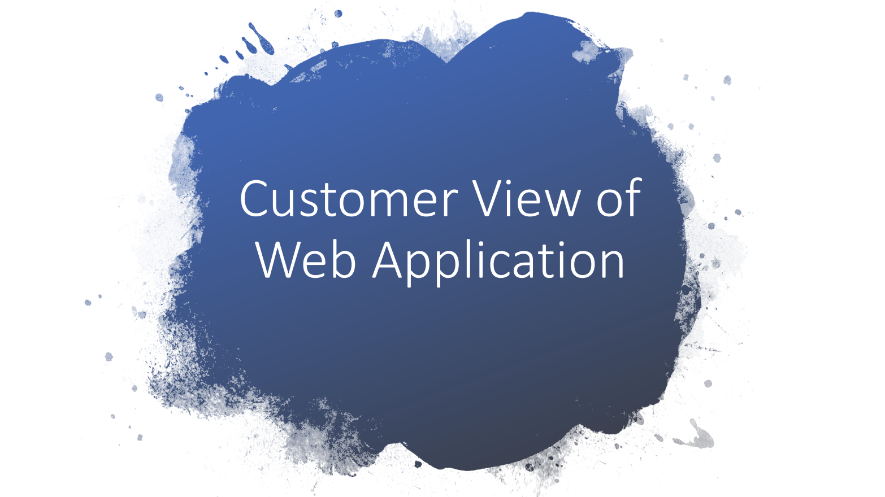
Notes:
First we will focus on customer view.

Slide 54
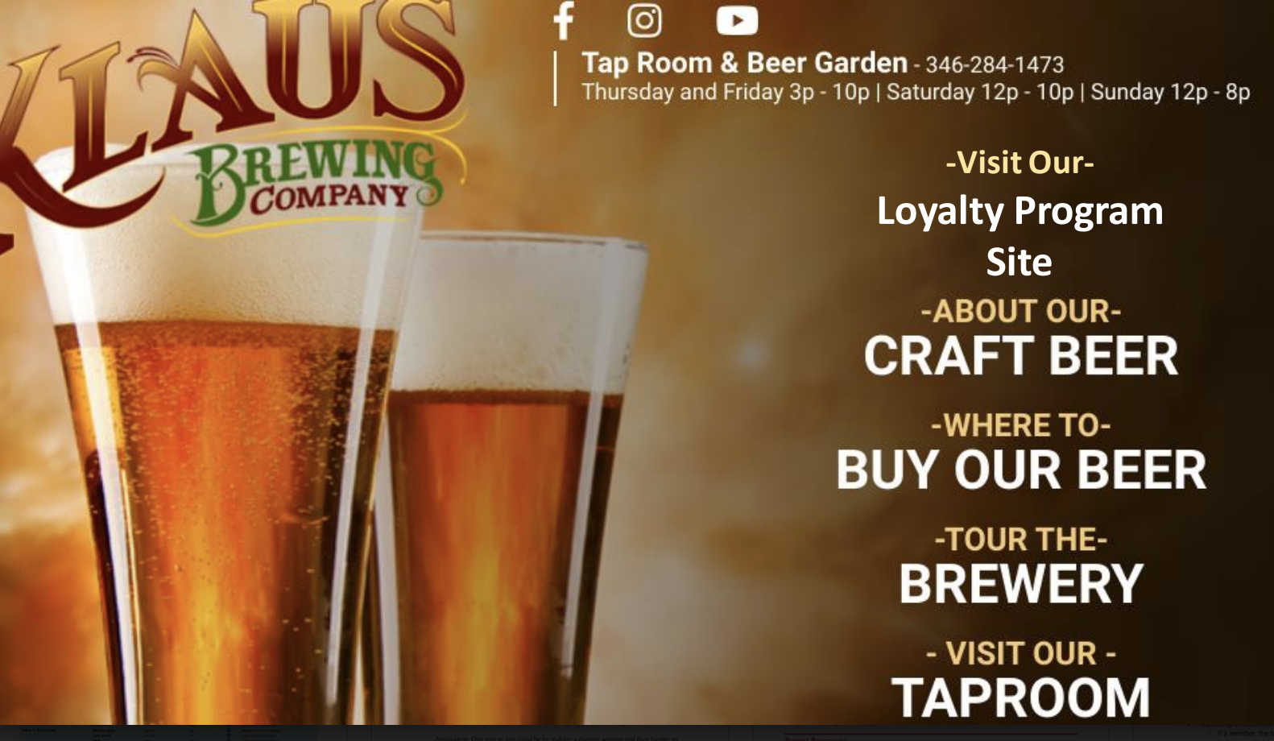
Notes:
Customer can access web application on Klaus’s main website. At the top is a link that will allow the customer to access the separate application. Moving on to the next slide.

Slide 55
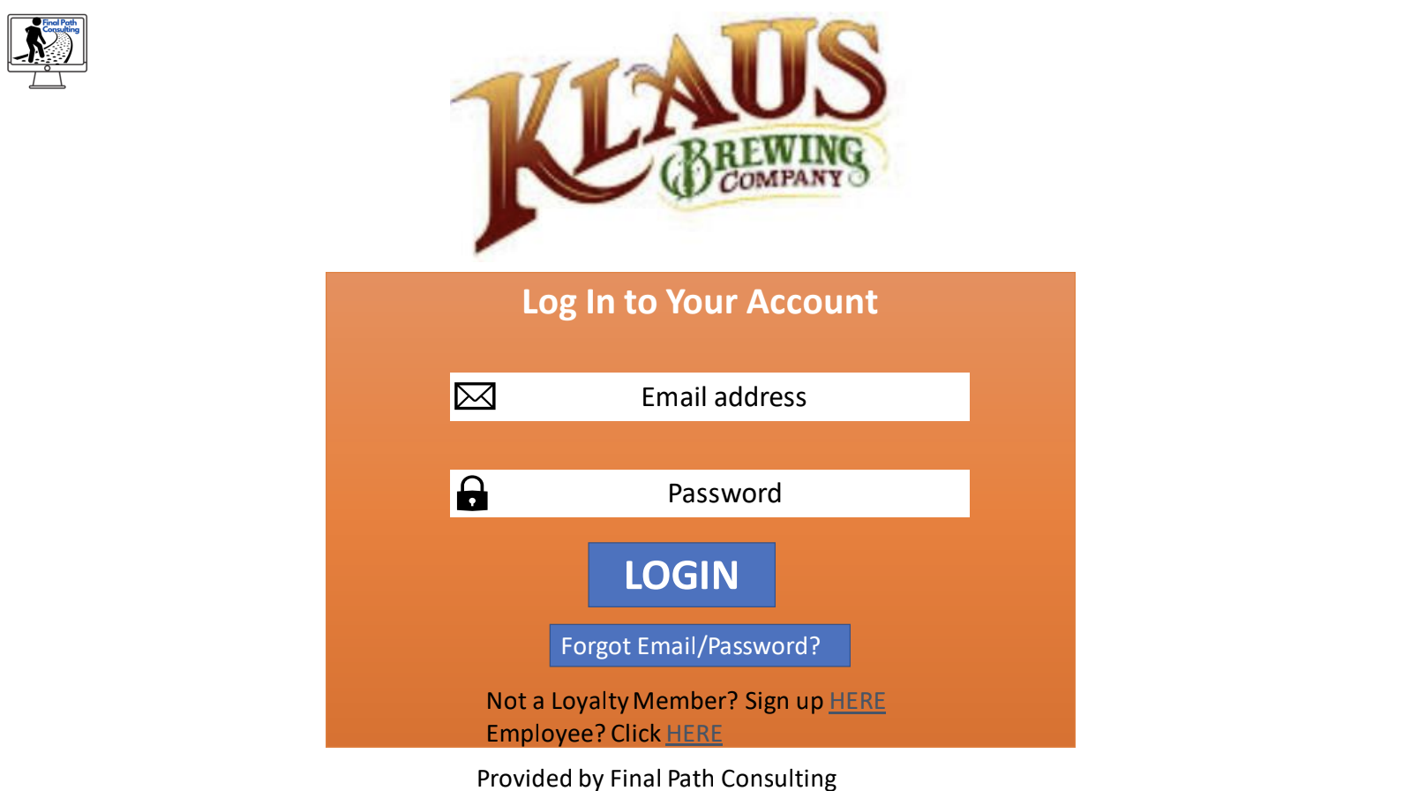
Notes:
The link will take them straight to the log in page. Next we will Go over some of the features.
If need to sign up they will click the sign up here and it will take them to the sign in form.

Slide 56
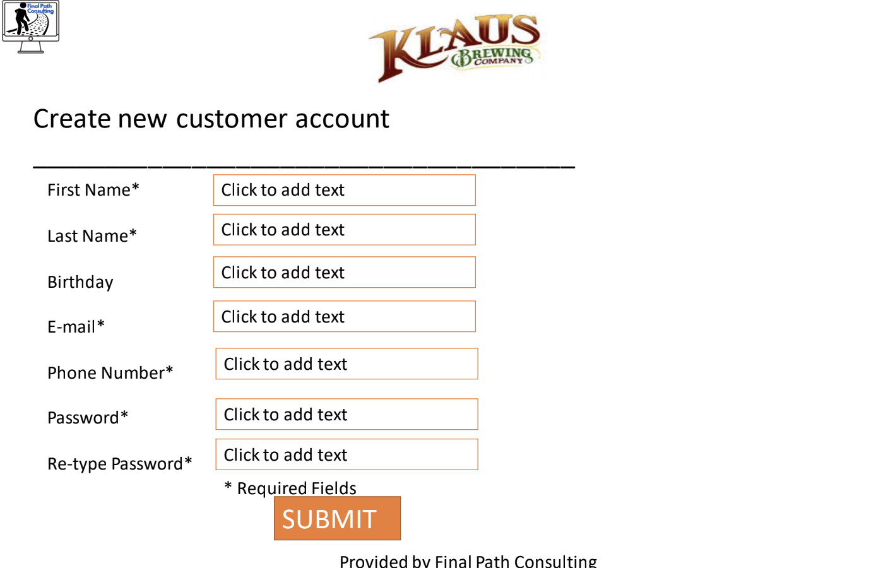
Notes:
In the sign up form the form will allow the users to add needed information such as email phone number and name. They can submit that information to create their profile. Next we will go over what the customer might see if they sign in as a returning customer.

Slide 57
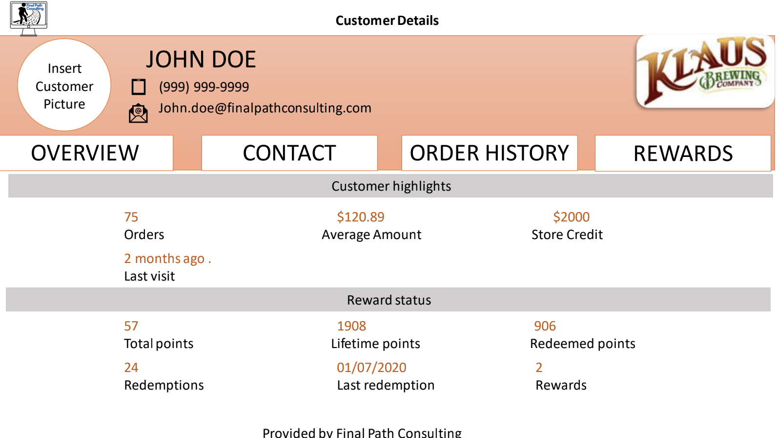
Notes:
The login page should give information about the customer as well as an overview of their loyalty information. To delve into the menu..

Slide 58
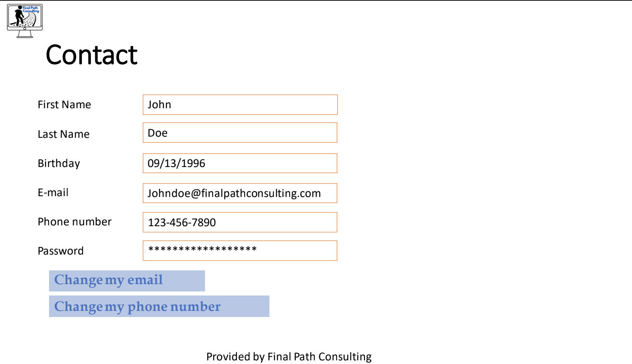
Notes:
The contact tab should provide contact information. Also provides the customer the ability to update information that might change such as an email or phone number.

Slide 59
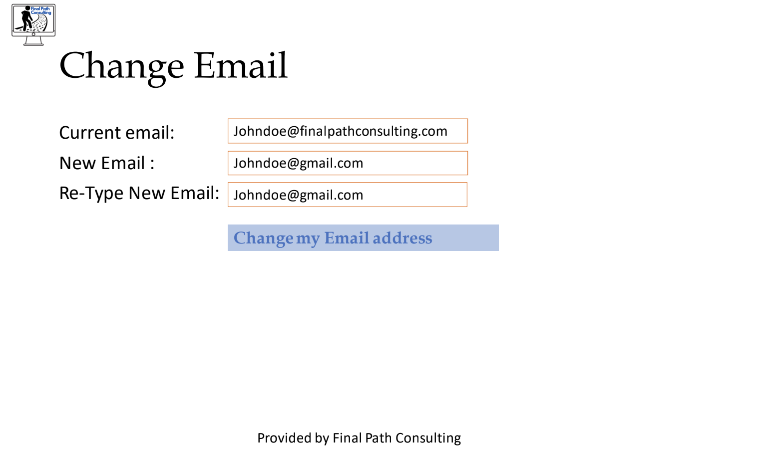

Slide 60
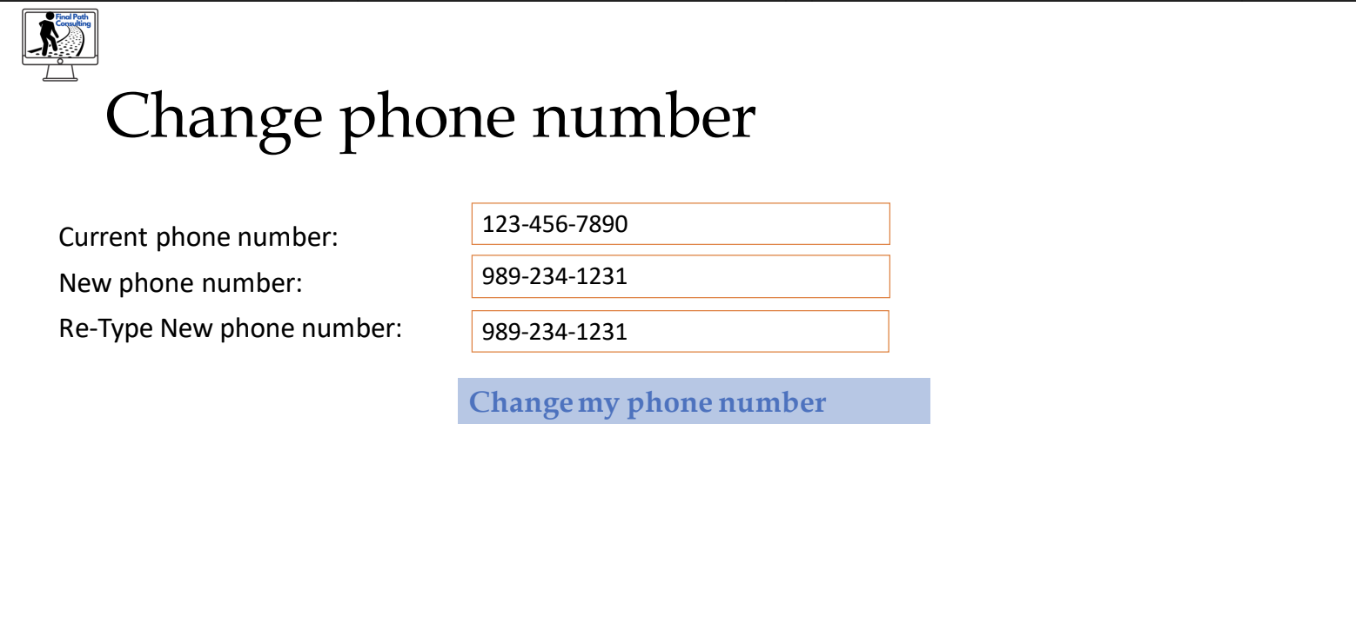

Slide 61
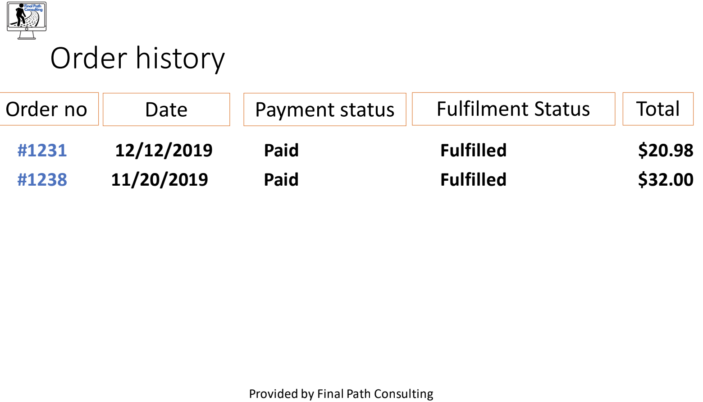
Notes:
Moving on to the order history tab this provides an overview of all their orders. They can click on the order no link to access even more information.

Slide 62
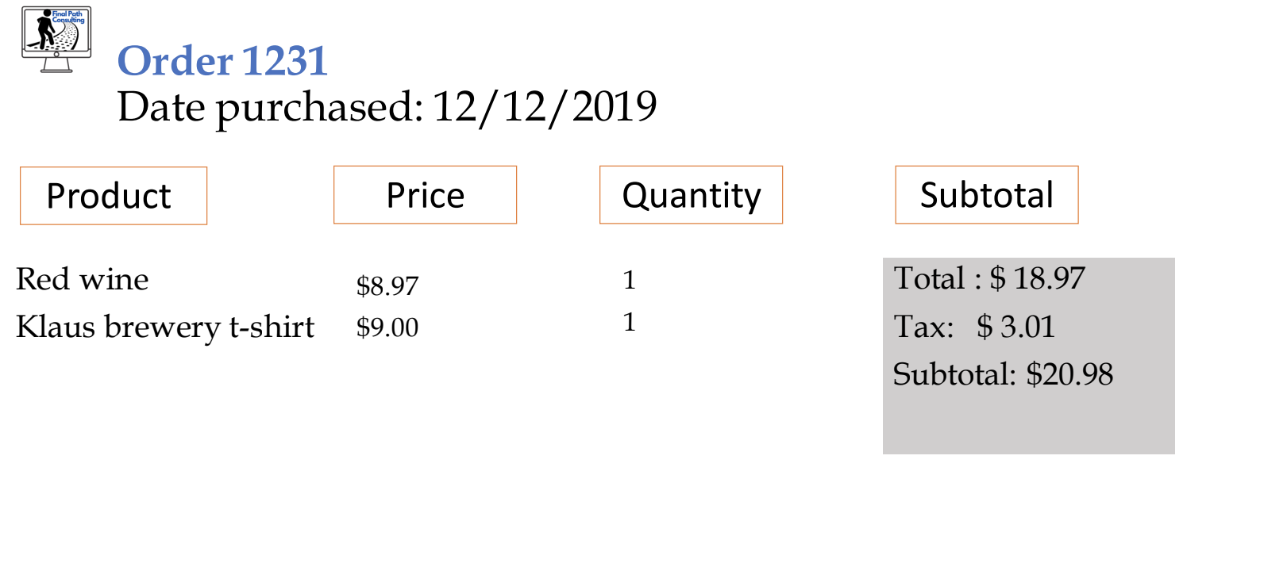
Notes:
Details of a specific order

Slide 63
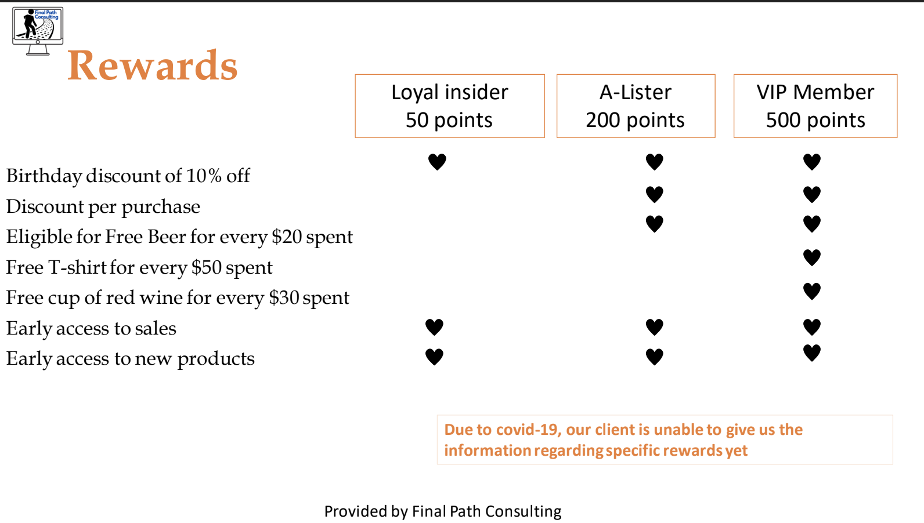
Notes:
Rewards

Slide 64
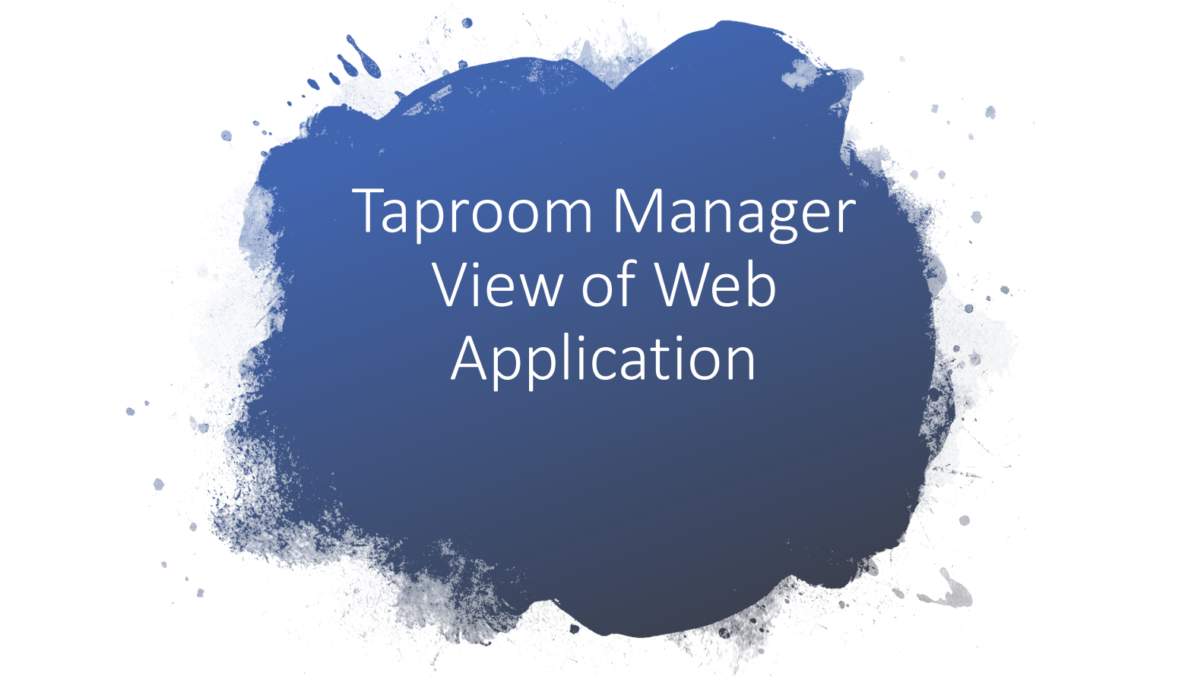

Slide 65
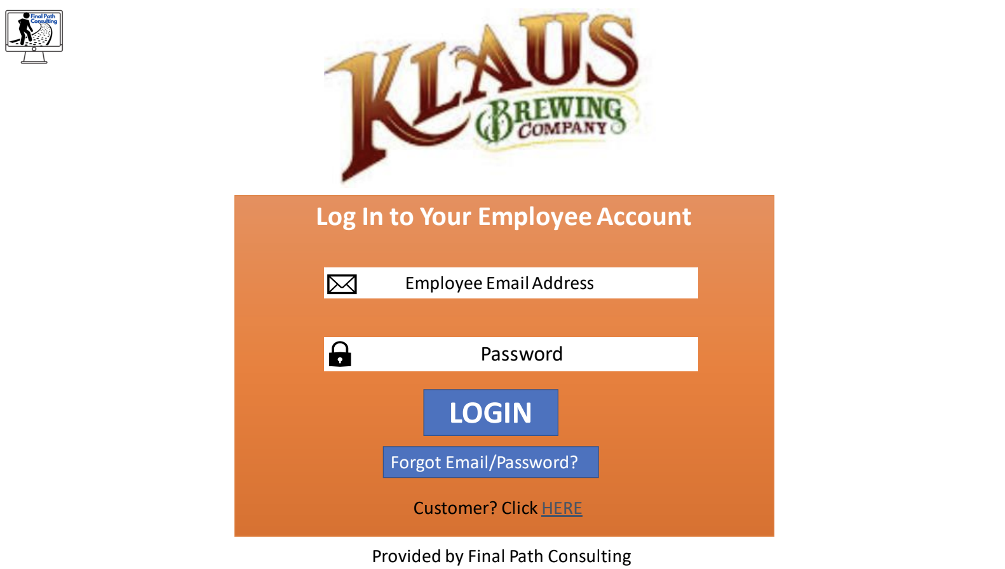

Slide 66
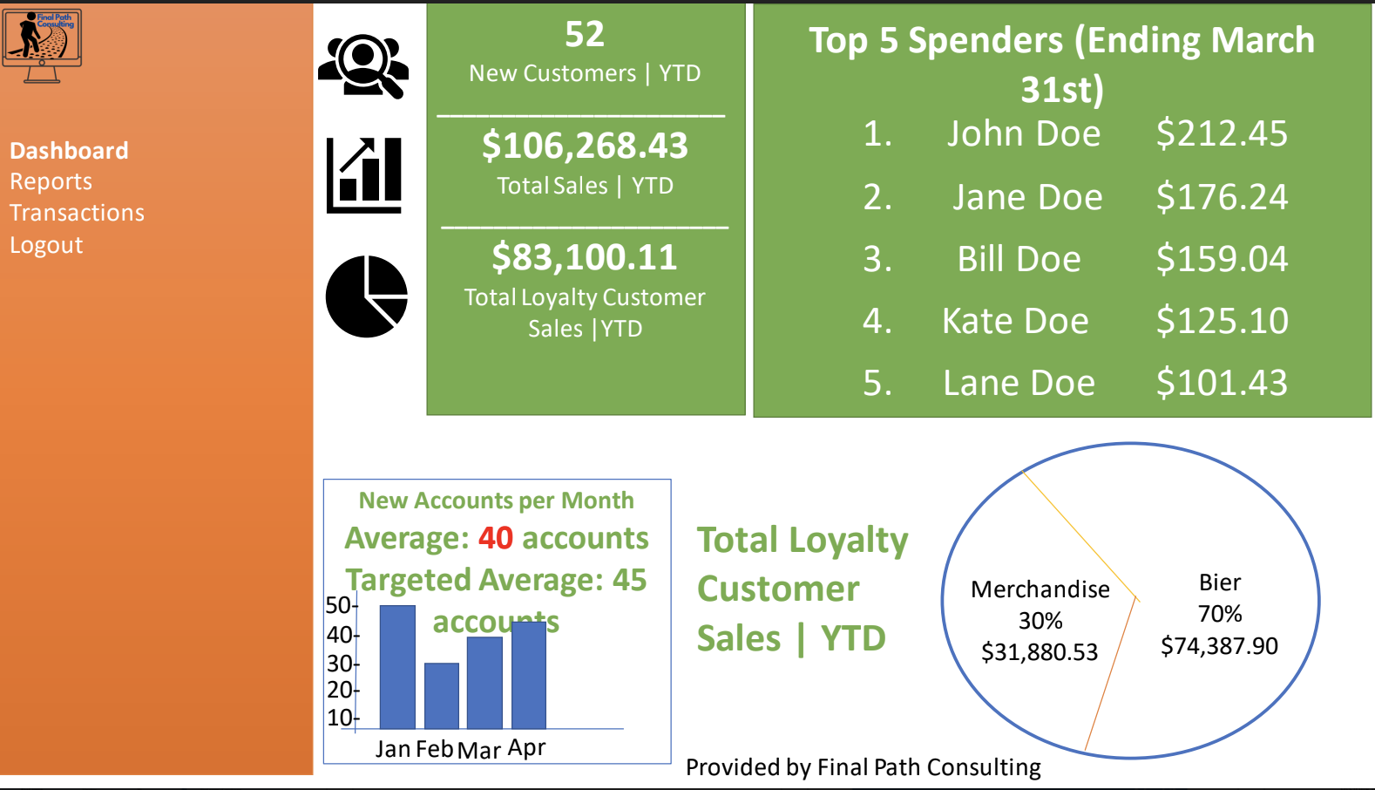

Slide 67
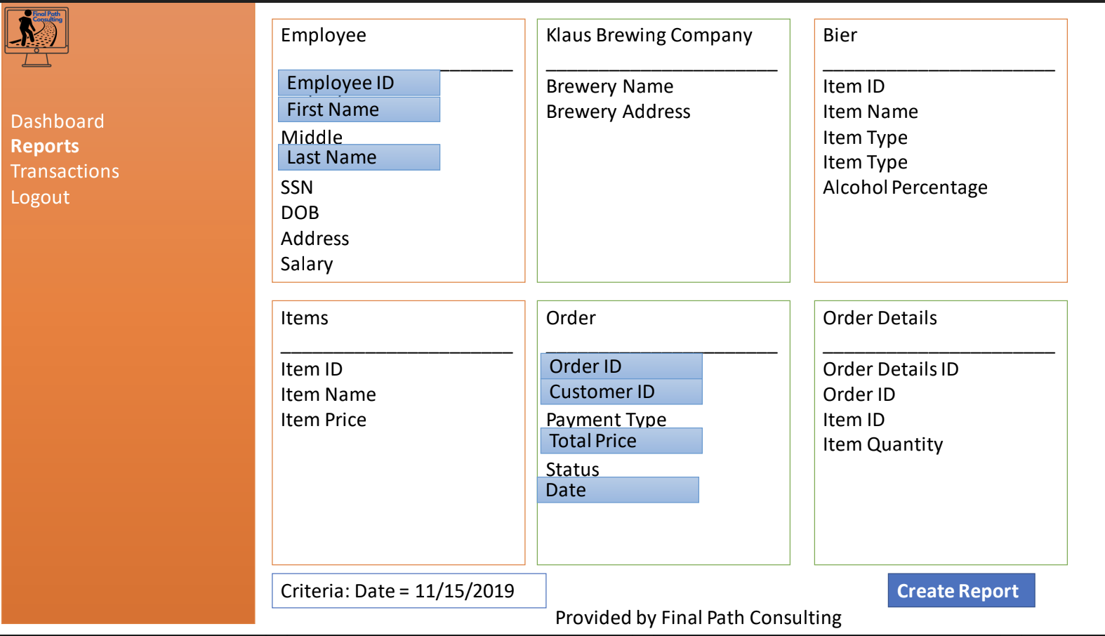

Slide 68
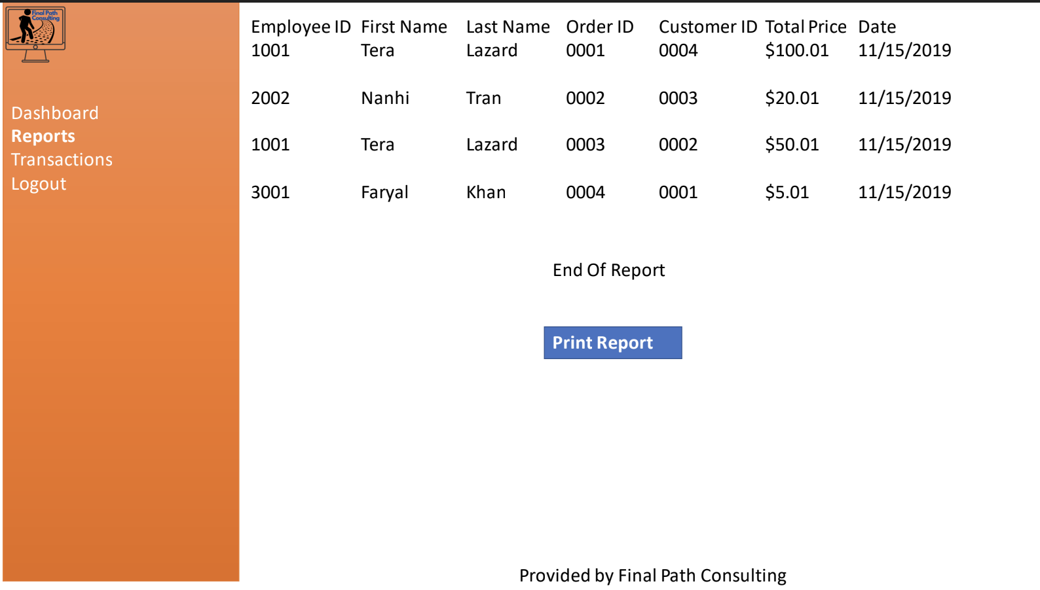

Slide 69
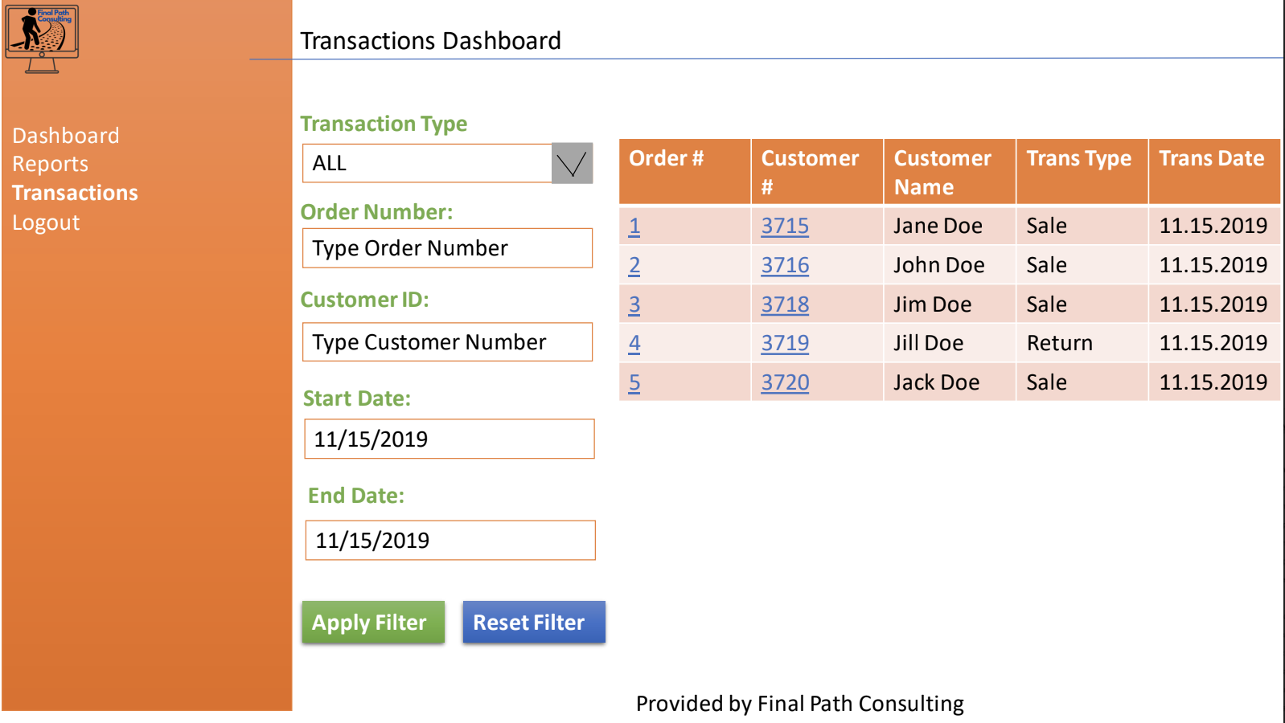

Slide 70
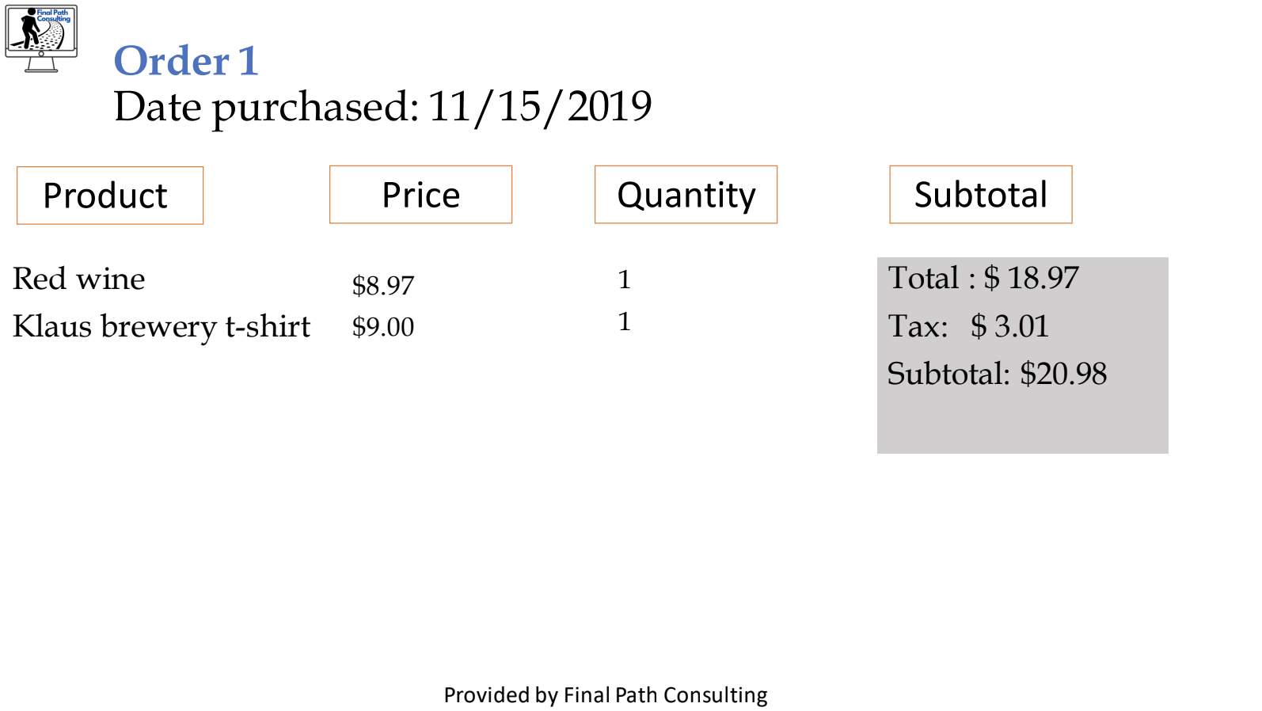

Slide 71
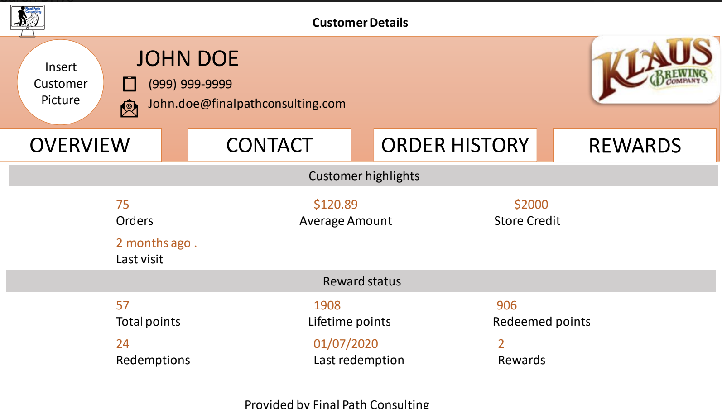

Slide 72
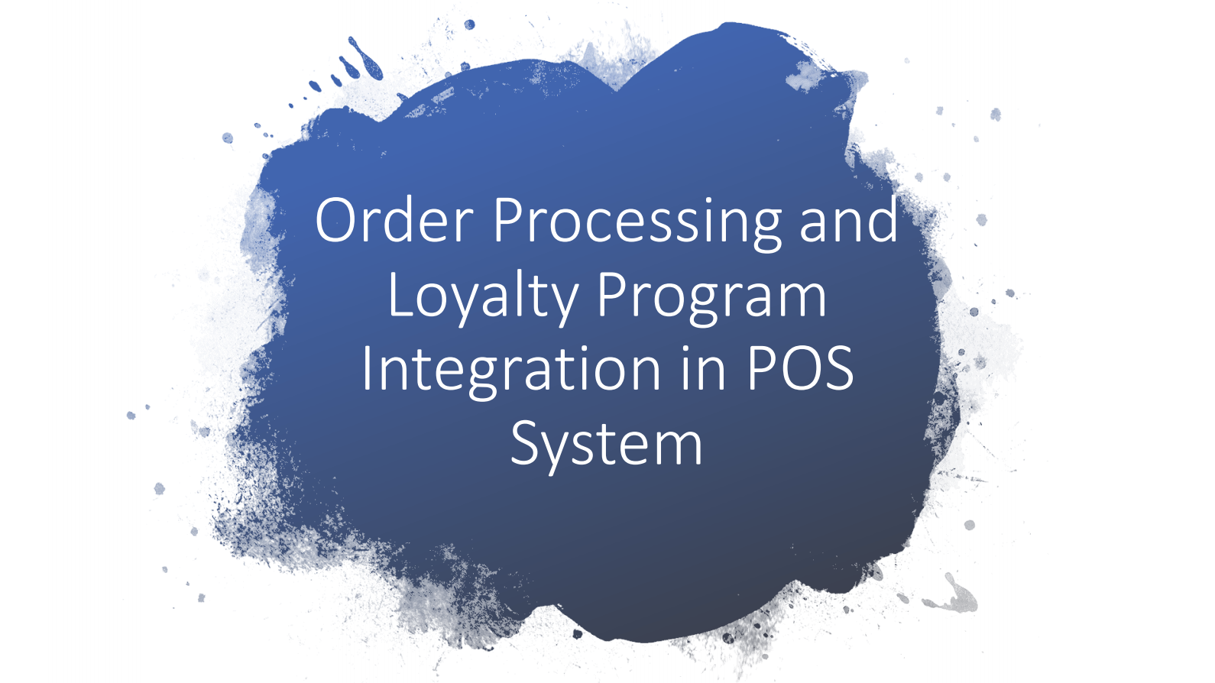

Slide 73
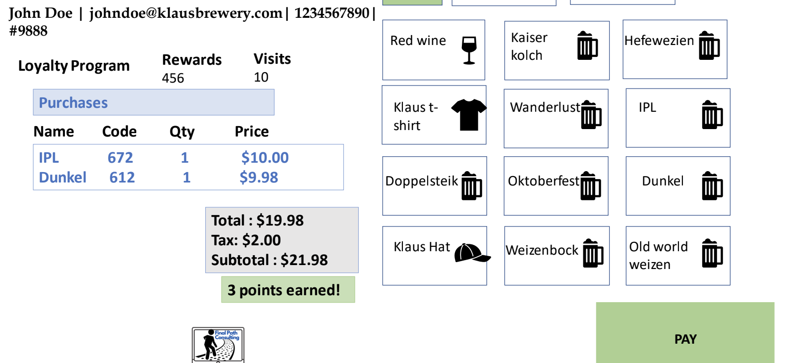
Notes:
Moving to next slide

Slide 74
EXECUTIVE SUMMARY OF OUR PROJECT
Final Path consulting began with the acquisition process of finding a client. We had the opportunity to work with a grocer, a salon, and some other businesses in greater Houston. Nevertheless, we came to the decision/opportunity to work with Klaus Brewing Company. After discussions with a group members, Nanhi (or liaison with our client), and Sean (a family member that is also a group member). We decided to move forward with our client to create their requested application needs. After multiple meetings with our liaison and other client workers, our group gathers information from our client utilizing open/closed ended questions from interviews with the stakeholders and regular employees that will utilize the system.
From there we defined where we will take the project. A back and forth from client, team, and professor took place to outline the framework and flow of where the project will go. After our conversations we came to the conclusion and agreement that we will be developing an order processing system, that will keep track of user information with what said users just purchased. Then after that we will create a loyalty program from the information given in customer forms. With this information we created the framework for our application that our client wants and needs for a better productive environment. So we started filling in the paperwork with our clients business information from client business rules, to what type of supplies and merchandise is available on hand. Then on our end we (the Final Path Consulting Team) created the outline for the database and how we will fulfill the requirements needed for the application from the problems given by the client.
Then to finish out, we will define the guidelines and the framework to the Loyalty Program through the requirements and suggestions from our liaison and staff. We will create the search parameters needed for all the requirements of customers to receive the incentives. With this project we laid the framework for an application to meet the needs of our client and the requested features they will like to use on a day-to-day effort. Utilizing an SQL database, a web based-application system, our client will have the ability to consolidate paperwork they used to fill and file by hand, gain valuable time that can be used in different fashions to build more profitability. And create a program to grow a recurring customer base that will be helpful to the company in the long run.

Slide 75
FINAL PROBLEMS AND REQUIREMENT LIST
Ref Number | Problem Description | Source | Date | Priority (M, K, D) | Rank | Requirements Description | Current Perfor-mance (Excellent, Fair, Poor) | Required Perfor-mance | Scope ("in" or "out")
2 | Upload spreadsheet form of merchandise and beir | Nanhi | 02/16/2020 | M | 5 | Solution allows for uploading of current spreadsheets | P | E | In
3 | Loyalty Program creation | Nanhi | 11/6/2019 | M | 7 | Solution allows for tables to be created depicting customer lastingness in brewery and what was purchased | F | E | In
1 | Electronic access to resources | Nanhi & Group | 02/10/20 | K | 1 | Create solution that allows company to access any forms, reports, customer info and order holdings online | P | E | In

Slide 76
LESSONS LEARNED
As a team throughout the semester, we have learned how to improve our communication. At the beginning of the project, there was a lack of communication where not all team members were responsive in the group chat and not everyone was stating their issues. However, the lack of communication caused several members to submit deliverables in the wrong format or with incomplete information. We had a group meeting before starting phase 2 and realized that few team members did not have a proper understanding of our project’s overall scope and due to them not having complete details, they were submitting wrong formatted and incorrect deliverables. After realizing that issue, we worked together as a team to come up with an effective form of communication and came to the conclusion that we need to be more consistent with our weekly meetings every week and everyone was asked to not hesitate in asking questions from their team and if they need any sort of help.
Another lesson that we have learned as a team is to use the professor’s given deliverables rubric to properly format each deliverable. Earlier in the semester, our team was confused about how to format their individual deliverables. However, After talking to our project manager and professor, we realized that the deliverables rubric was supposed to assist in formatting each document.
Due to COVID 19, our team had to adapt to how to work from home on our project with no face to face interaction. In the beginning, it was a bit complicated to adjust to such sudden change, however through the use of Microsoft TEAMS, our team soon adjusted to this change by scheduling weekly meetings on Microsoft teams instead of face to face.

Slide 77
REFERENCES
“Brewers Association Releases Annual Growth Report.” Brewers Association, 2 July 2019, www.brewersassociation.org/press-releases/brewers-association-releases-annual-growth-report/.
Egan, John. “Houston's Big Population Boom Continues with This Many New Residents Each Day.” CultureMap Houston, 24 Apr. 2019, houston.culturemap.com/news/city-life/04-23-19-houston-the-woodlands-sugar-land-population-growth-us-census/.
Takahashi, Paul. “Houston's Craft Beer Craze More than Doubles Brewery Space in Six Years.” Houston Chronicle, Houston Chronicle, 23 Aug. 2019, www.chron.com/business/texas-inc/article/Houston-s-craft-beer-craze-more-than-doubles-14370128.php.
“What's on Tap...” Home, www.klausbrewing.com/.
“Understanding Use Cases.” Understanding Use Cases - IHRIS Wiki, wiki.ihris.org/wiki/Understanding_Use_Cases.
Interviews with Klaus Brewery management
Results from data gathering
Class Lectures
Notes
Environment of business

